Slide 1

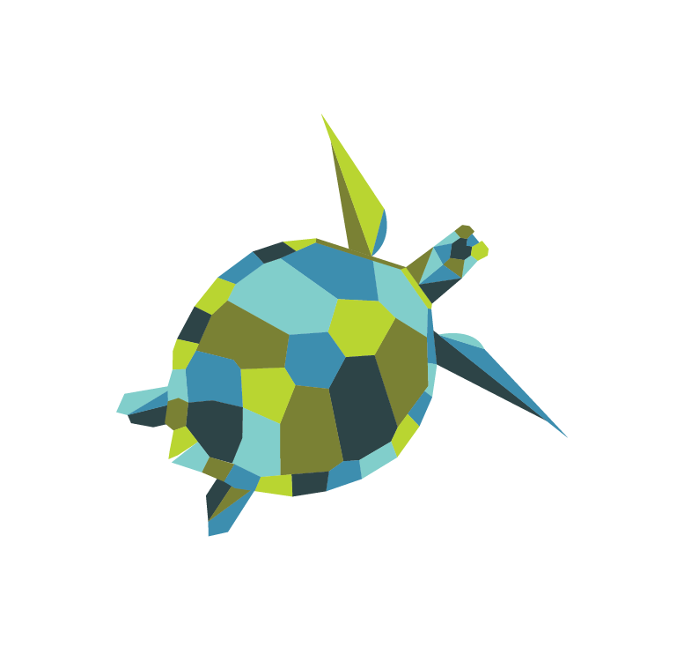
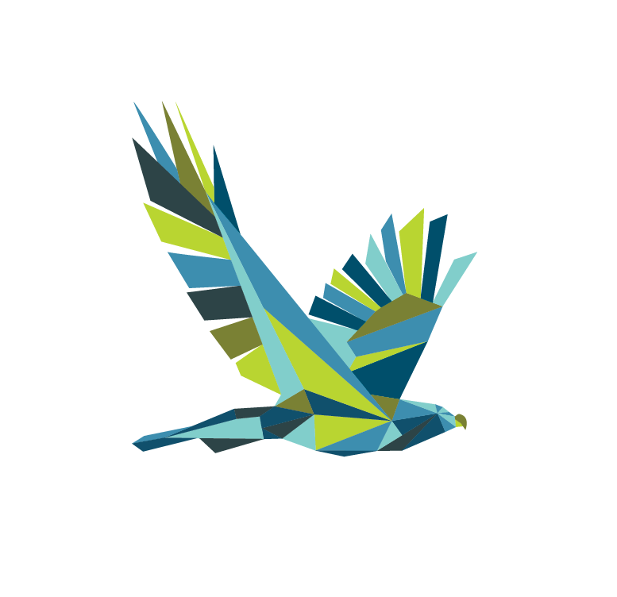
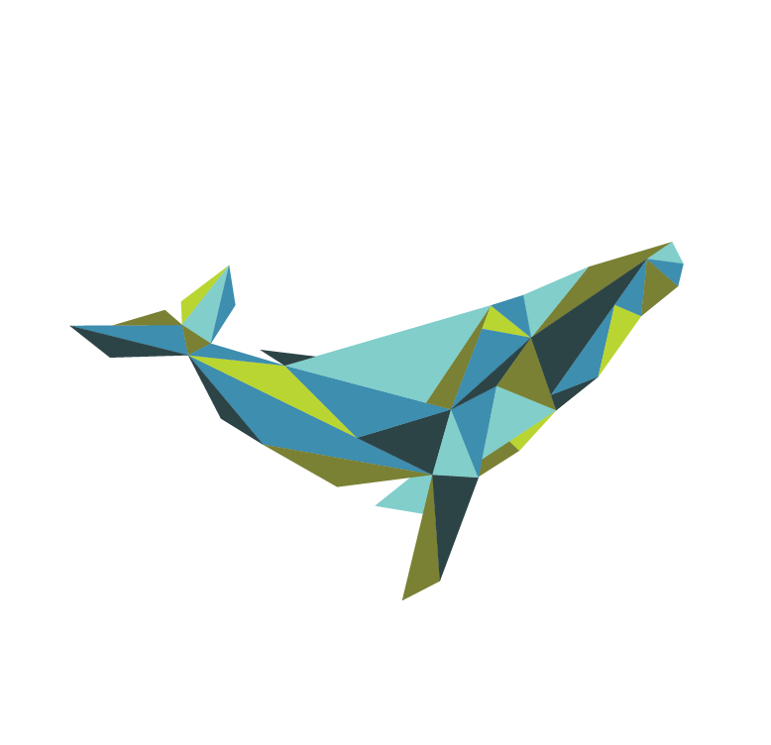
Ocean Connectors
Connecting Youth for Conservation
María Hernández, Binational Programs Coordinator

Slide 2
Mission
Educate, inspire, and connect youth in underserved Pacific coastal communities through the study of migratory marine life
Goals
EDUCATE students to increase academic engagement, support classroom learning goals, and motivate them to pursue ocean-STEM careers.
INSPIRE environmental stewardship by introducing children to the tools, knowledge, and awareness to actively practice conservation.
CONNECT youth with the ocean and provide access to diverse, hands-on learning opportunities in coastal environments.

Slide 3
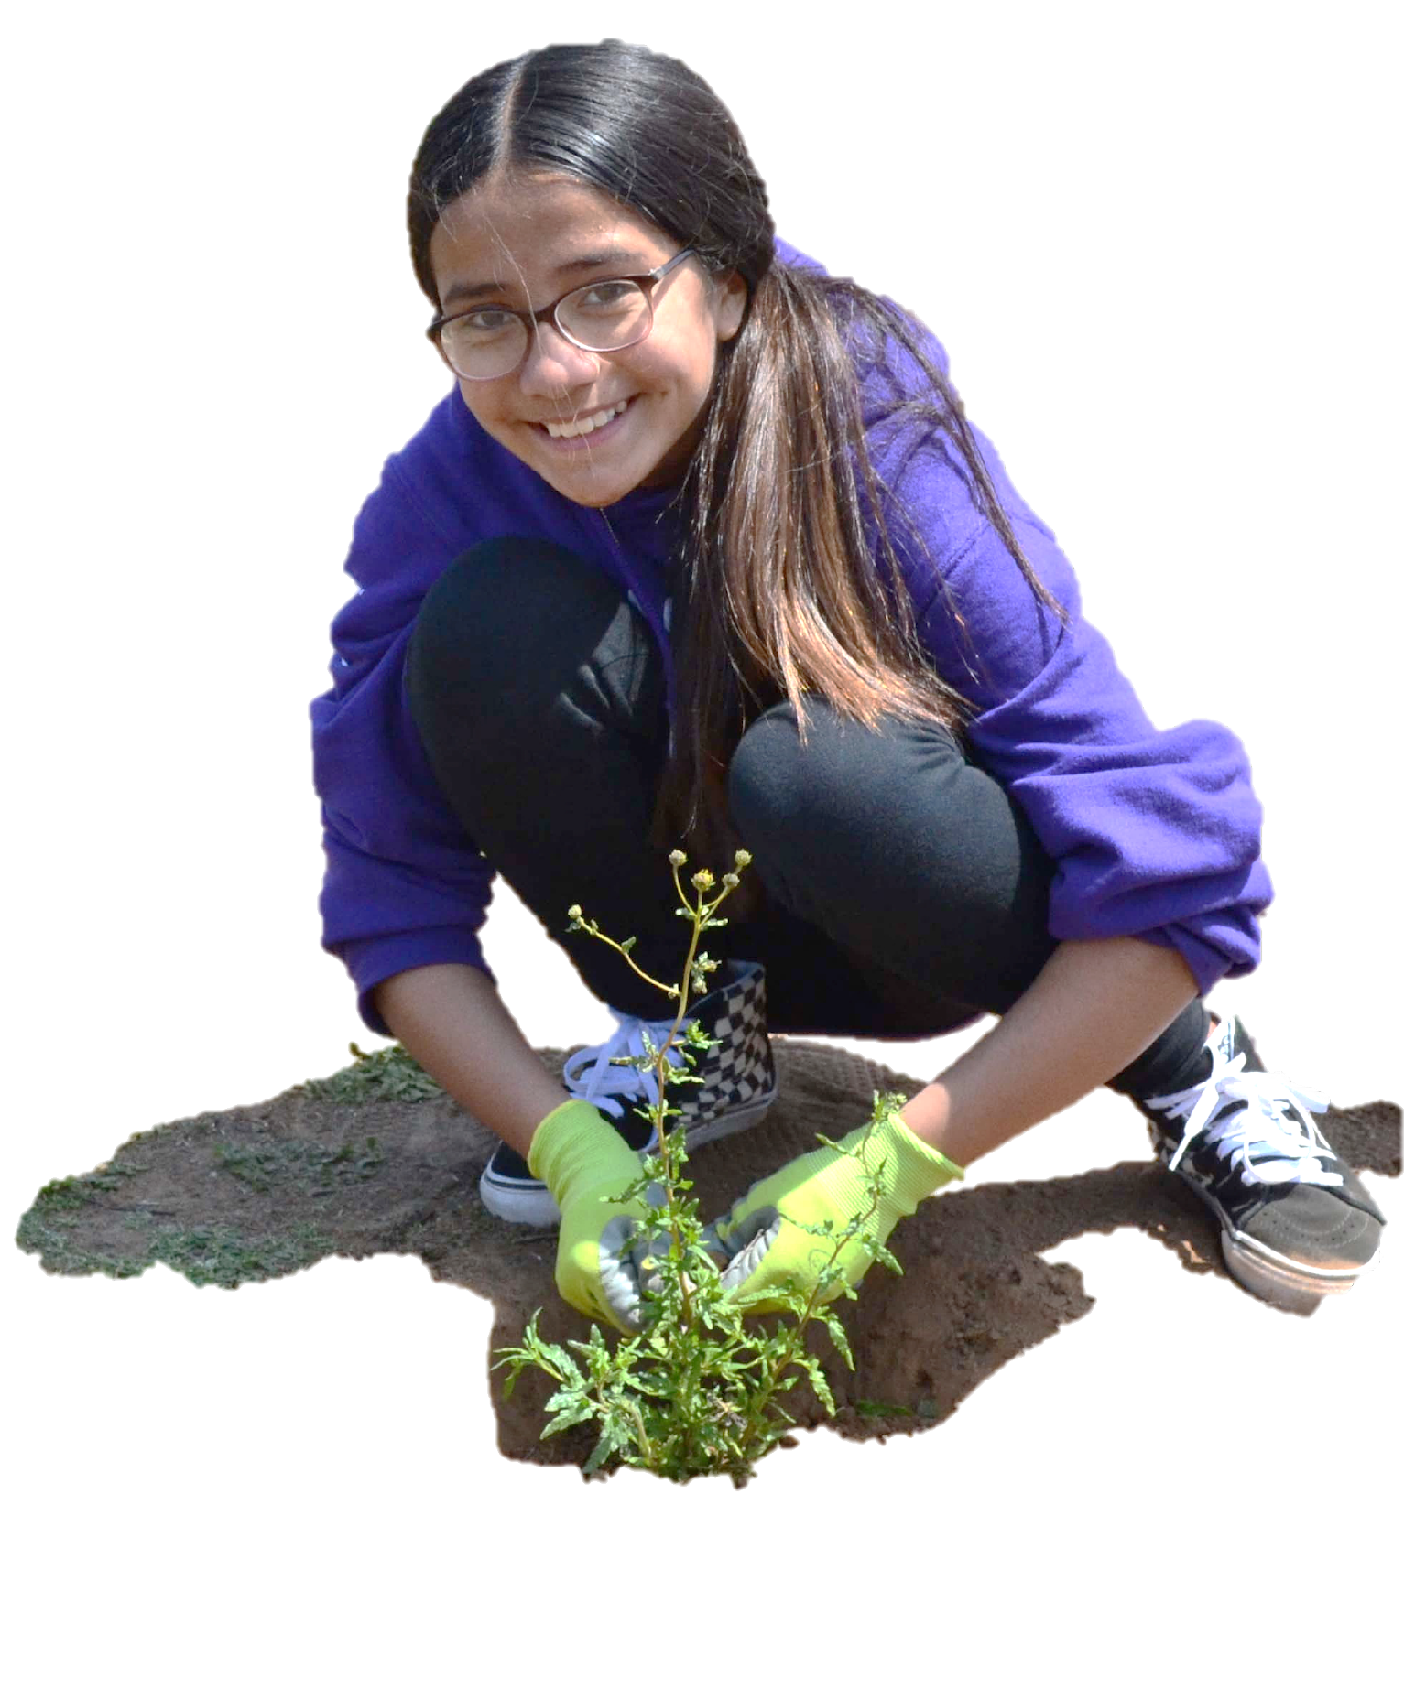
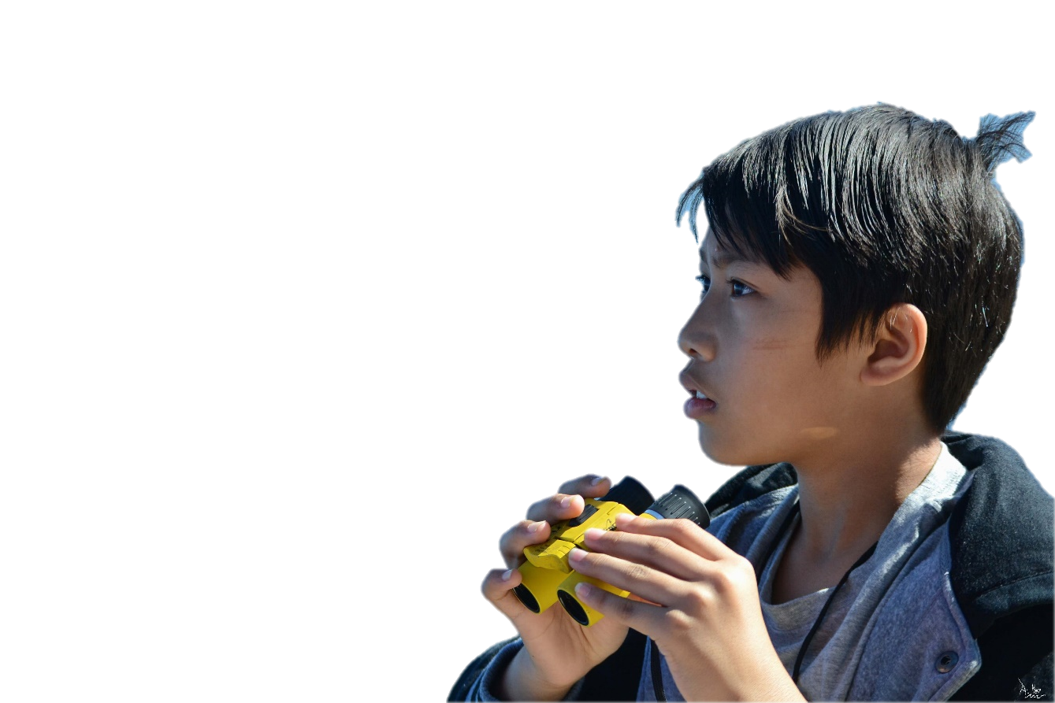
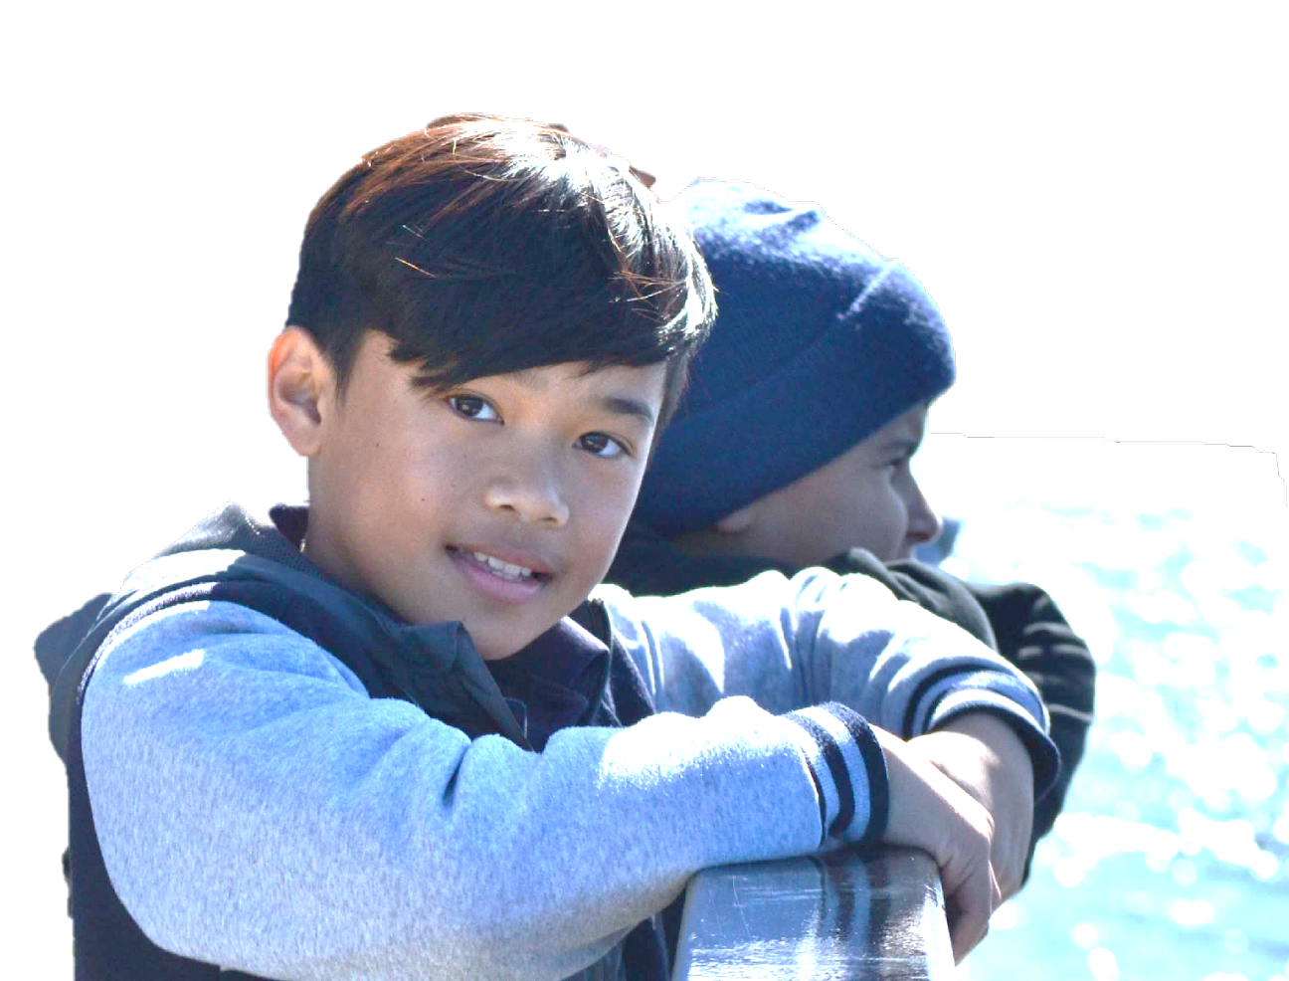
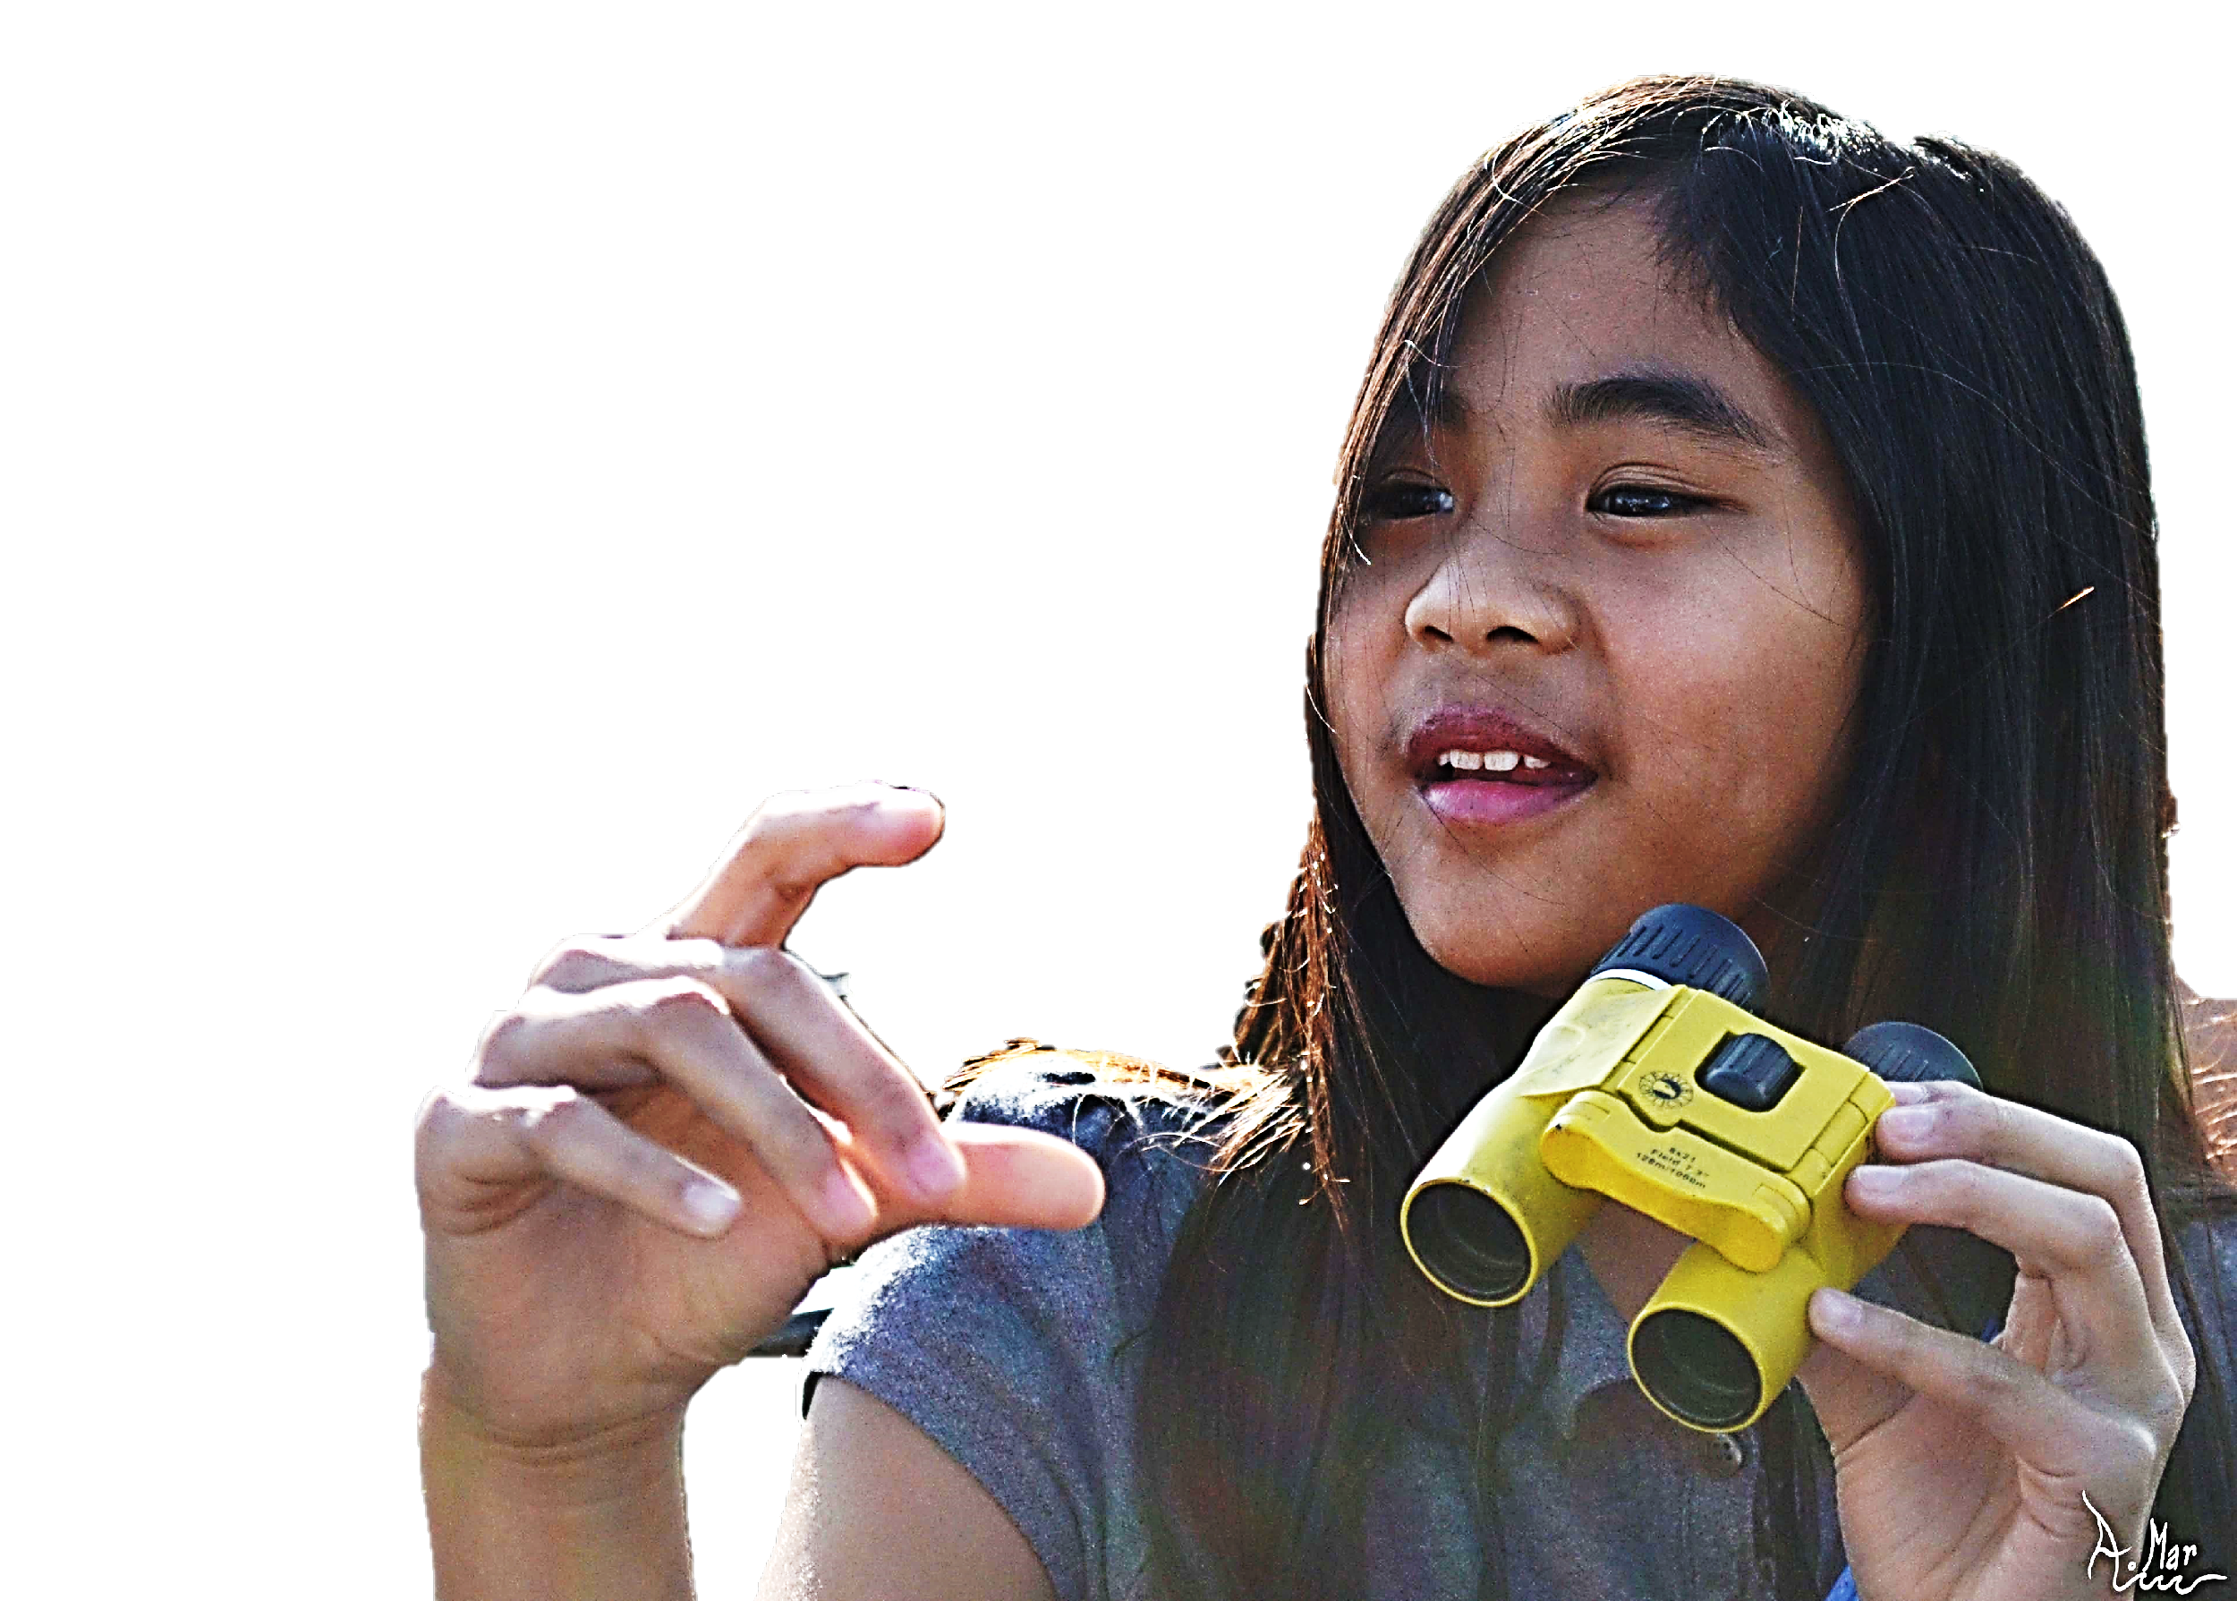
Vision
Cultivate a future generation of passionate, globally-­aware, and empowered coastal residents who take active steps to enjoy and protect ocean health

Slide 4
Our Values
CONNECTING WITH NATURE
Bringing students on exciting, hands-on field trips in coastal environments
EDUCATIONAL ACHIEVEMENT
Enriching the public school system by keeping students engaged, stimulated, and inspired by the learning process
EQUITY & INCLUSION
Taking care to understand and honor the diverse cultures, identities, and backgrounds that make our audience and our team unique
REAL-WORLD SCIENTIFIC SKILLS
Encouraging students to form linkages between scientific inquiry and everyday life using experiential teaching techniques
WILDLIFE & HABITAT CONSERVATION
Engaging youth in conservation so they form an understanding of the importance of protecting marine environments and biodiversity

Slide 5
Milestones for USA
In the Beginning
2007 – Ocean Connectors established under Pro Peninsula (sea turtle focus)
2009 – Joined The Ocean Foundation as fiscal sponsorship project
Program Growth
2010 – Added new whale program for 5th grade
2011 – Added new bird program for 6th grade (habitat restoration)
2016 – Enrolled 100% of National School District
2016 – Launched Eco Tours social enterprise
2017 – 10 year anniversary
2018 – Added new shark program for 7th grade
Pandemic and Pivoting
2020 – Virtual education
2021 – New development plan, new website, social media, Eco Tours opening
2022 – Expanding into all 3rd grade classes in all 10 schools

Slide 6
Milestones for Mexico
Program Growth in Mexico
2007 – Started working in Baja California
2010 – Moved the programs to Nayarit
2011 – Multiyear curricula 4th thru 6th grades
2017 – Instructor dedicated to Mexico was hired
2020 – Binational Programs Coordinator position was created to expand the programs
2021 – New partnership with Costa Canuva
Pandemic and Pivoting
2020 – Developing of booklets
2021 – New educational materials
2022 – 2 visits per group

Slide 7
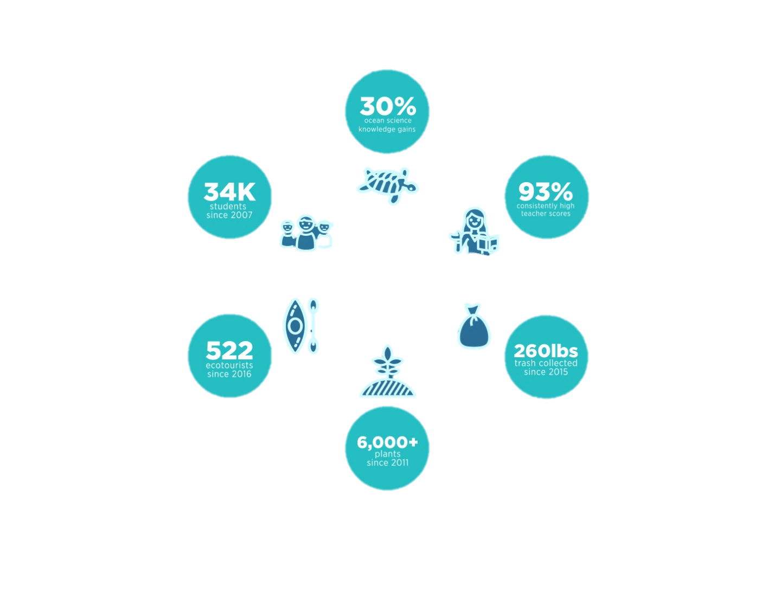

Impact

