Slide 1
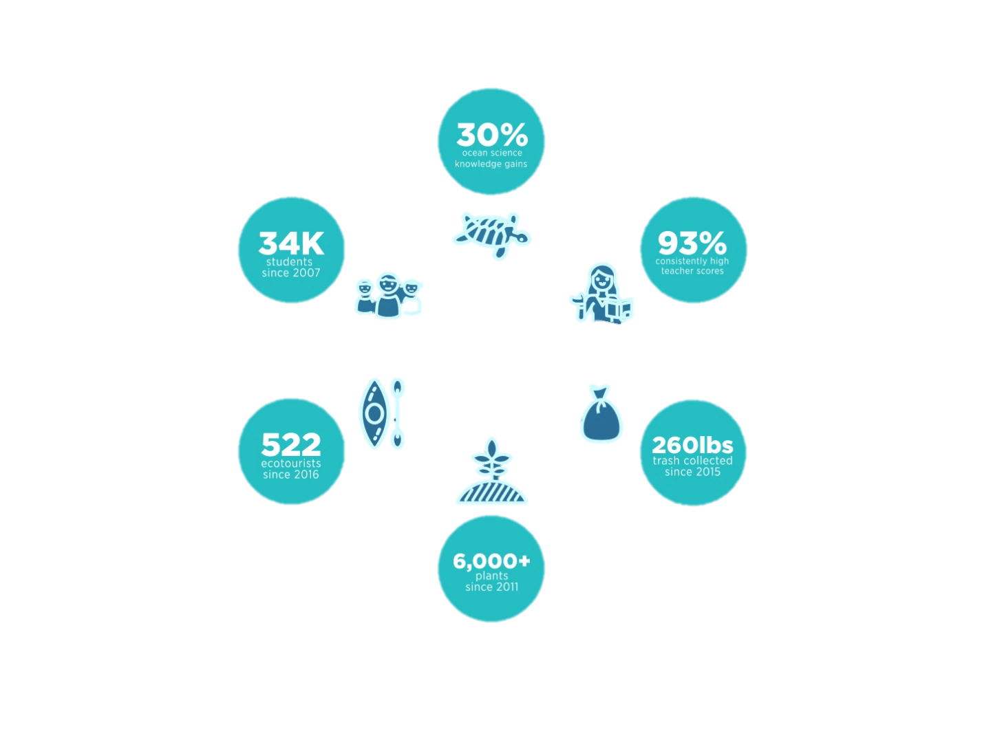

Impact

Slide 2
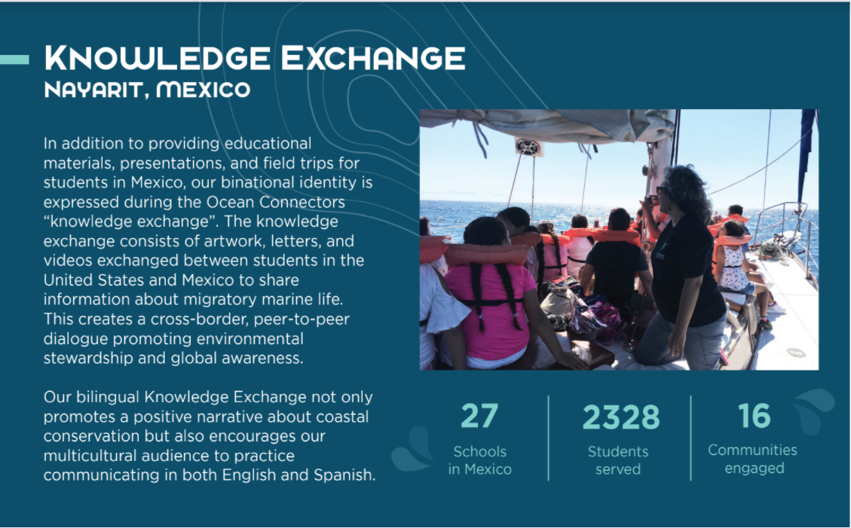

Slide 3

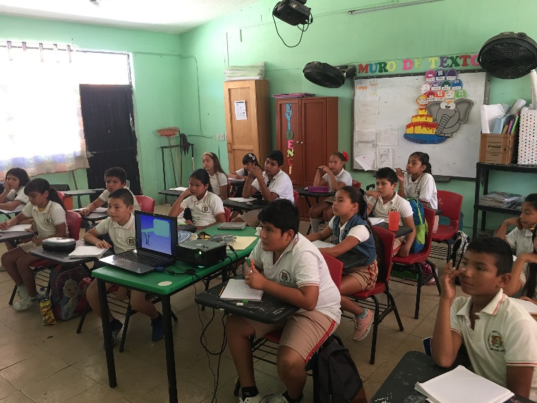
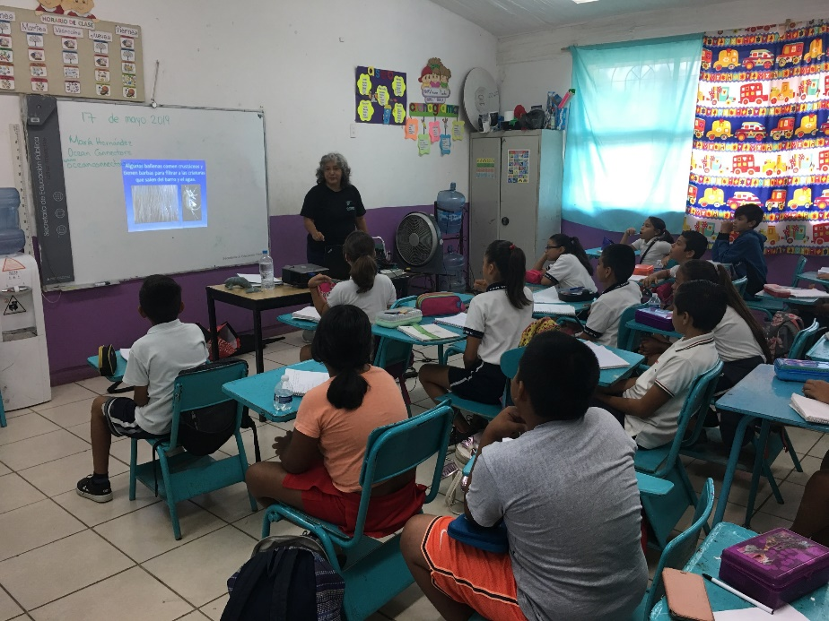
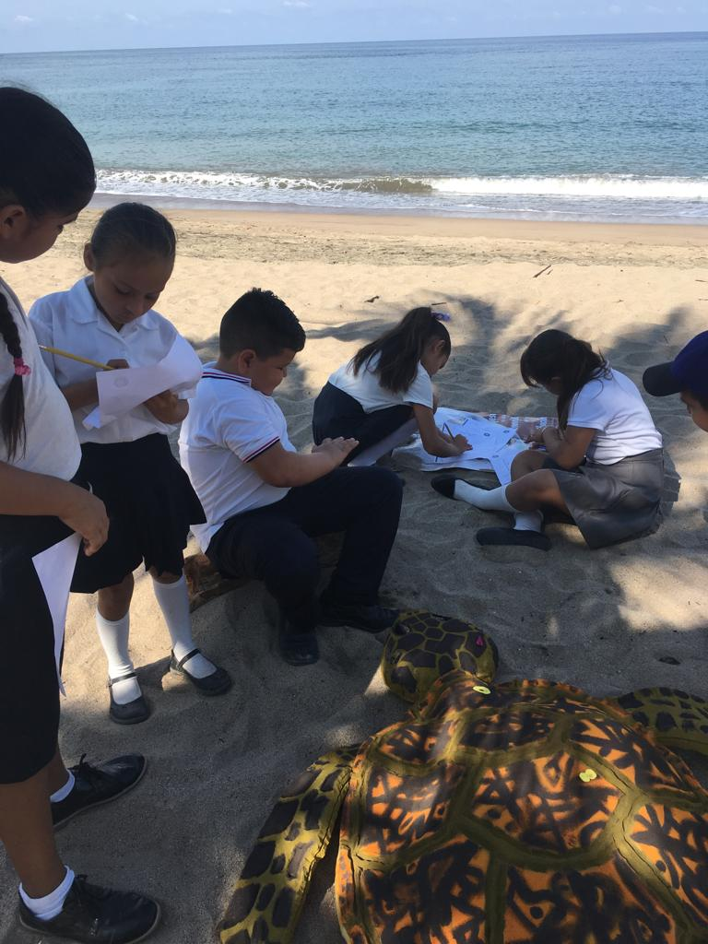
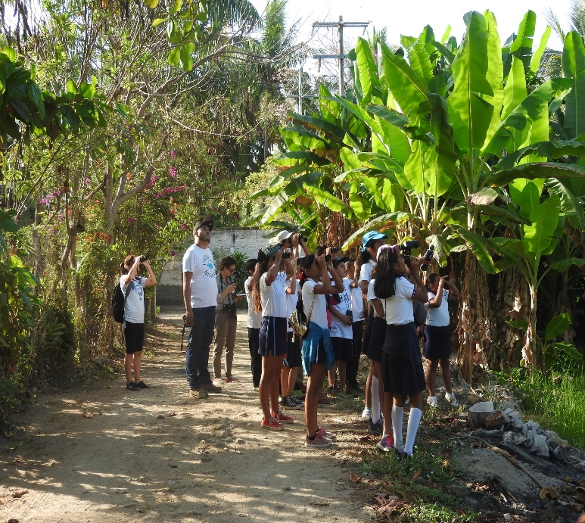
Program Elements
Classroom Presentations
Knowledge Exchange
Coastal Field Trips
Evaluations
  Teacher Feedback
  Knowledge Gains
  Attitude and Behavior Changes
  Habitat Restoration Outcomes
“User Guide” Binders
Resources Webpage

Slide 4
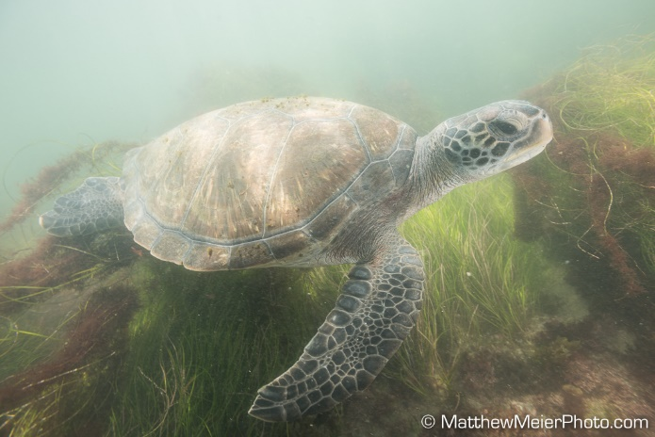
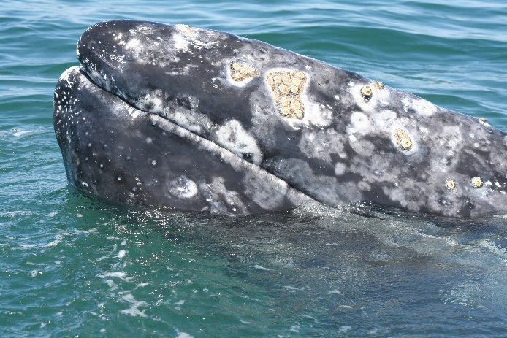
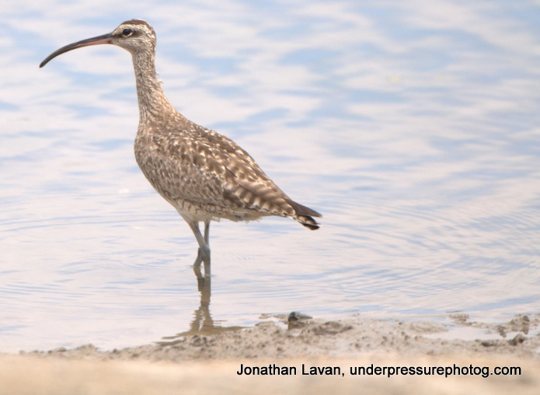
Multiyear Curricula
4th Grade: Sea Turtle Discovery
Knowledge Exchange = sea turtle stamp artwork
Field Trip = students observe sea turtles at aquarium or turtle camps
Conservation Themes: recycling, waste management, single-use plastics
5th Grade: Whale Exploration
Knowledge Exchange = bilingual pen-pal letters
Field Trip = whale watching excursions or interactive activities.
Conservation Themes: sustainable seafood, bycatch, Noise Pollution in in the Ocean
6th Grade: Bird & Habitat Study
Knowledge Exchange = video production
Field Trip = bird watching and habitat restoration
Conservation Themes: coastal development, climate change, habitat loss

Slide 5
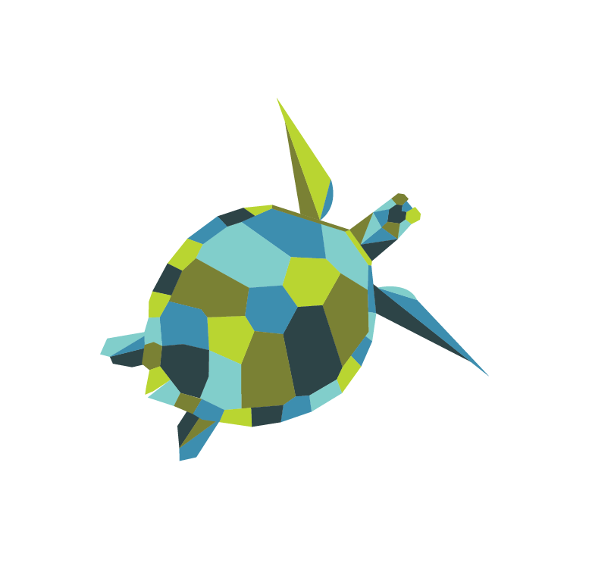





Follow Ocean Connectors Online
oceanconnectors.org
@OceanConnectors
#BeAnOceanConnector
info@oceanconnectors.org
facebook.com/oceanconnectors

Slide 6



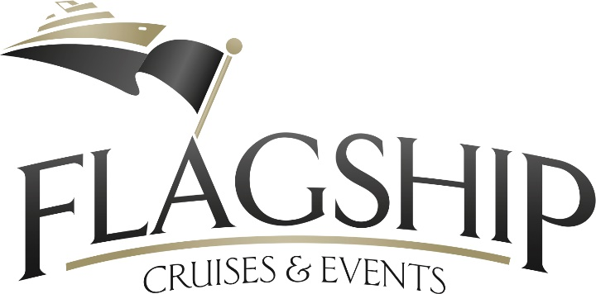



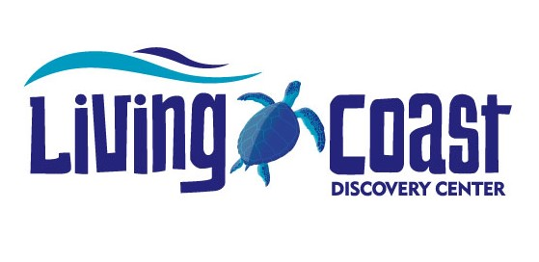





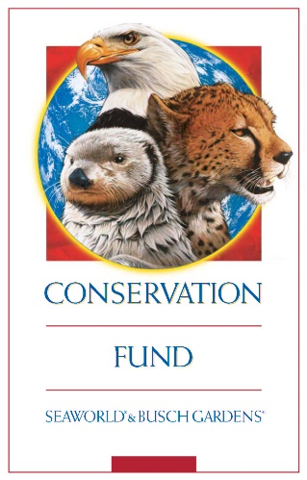


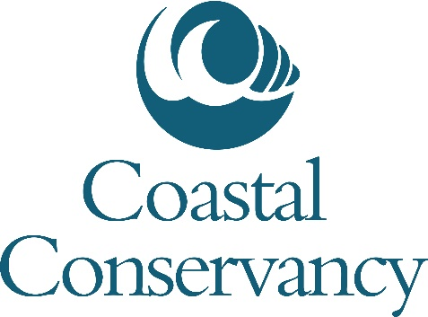

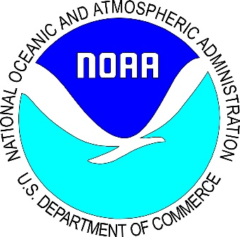
Partners

Slide 7
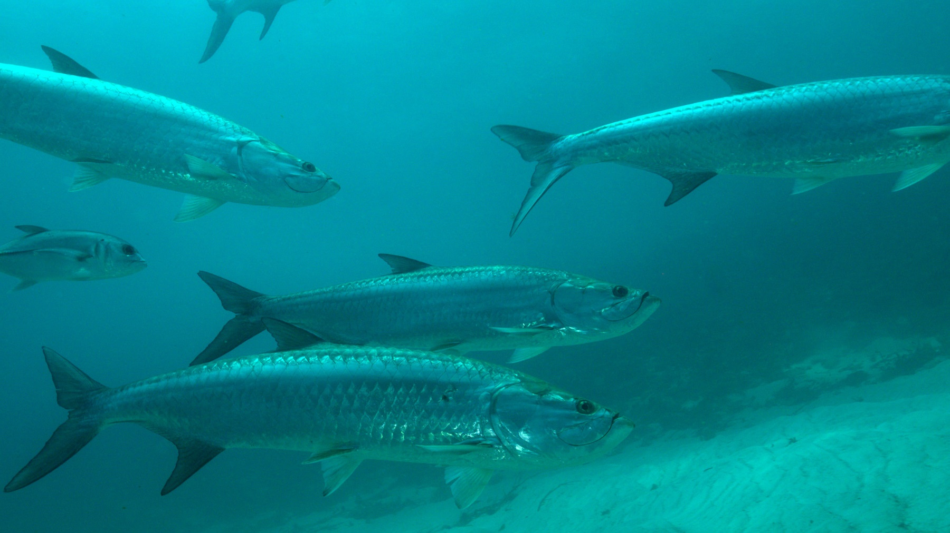
Questions?
Frances Lang
Executive Director, Ocean Connectors
frances@oceanconnectors.org
Maria Hernandez
Binational Programs Coordinator, Ocean Connectors
maria@oceanconnectors.org
Mandy Shefman
Development Manager, Ocean Connectors
mandy@oceanconnectors.org

