Slide 1

PARANAL – A CONAFE SCHOOL
In Mexico there are two separate but unequal school systems. One is Secretaría de Educación Pública (SEP) the main school system that has over 18 students per classroom and the other is CONAFE (Consejo Nacional de Fomento Educativo) with 4 to 17 students that is a decentralized agency of SEP (English: Ministry of Public Education), whose task that is not in the SEP schools, is to provide basic education services from early childhood to children between zero and three years eleven months old and to children and adolescents living in areas of high and very high marginalization of the country, where it is not possible to have a regular educacional servicie.
It has come to our attention through communicating with two supervisors of CONAFE schools and visiting of various schools in the CONAFE school system (National Council for the Promotion of Education) that the needs of these schools are not met as other SEP schools. However, depending on the involvement of the parents and the towns, some schools have facilities up to standard. They all lack the daily consumables like crayons, tablets, workbooks, notebooks, paper, pencils, markers etc.
THE FOLLOWING PRESENTATION IS FOR ONE OF THOSE SCHOOLS THAT DOES NOT HAVE FACILITIES UP TO STANDARD

Slide 2
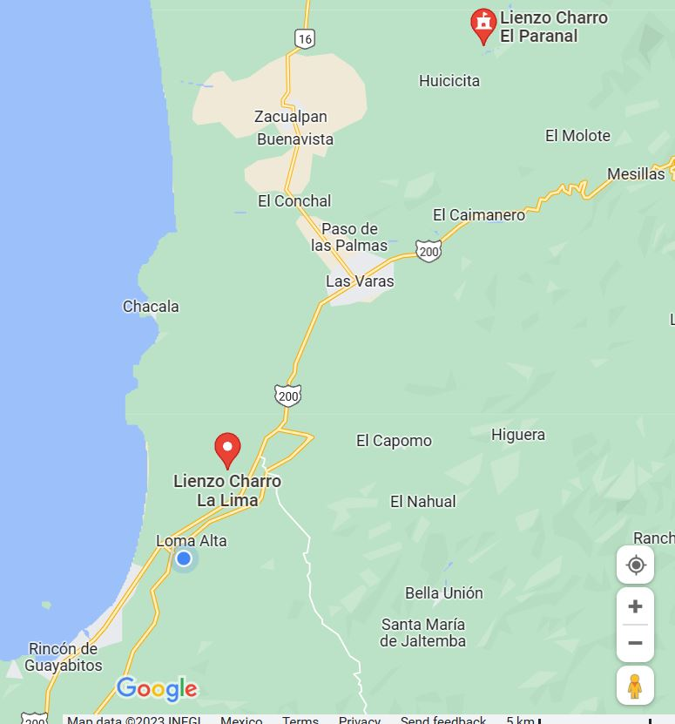
PARANAL - IT LOOKS FARTHER THAN IT IS.

Slide 3
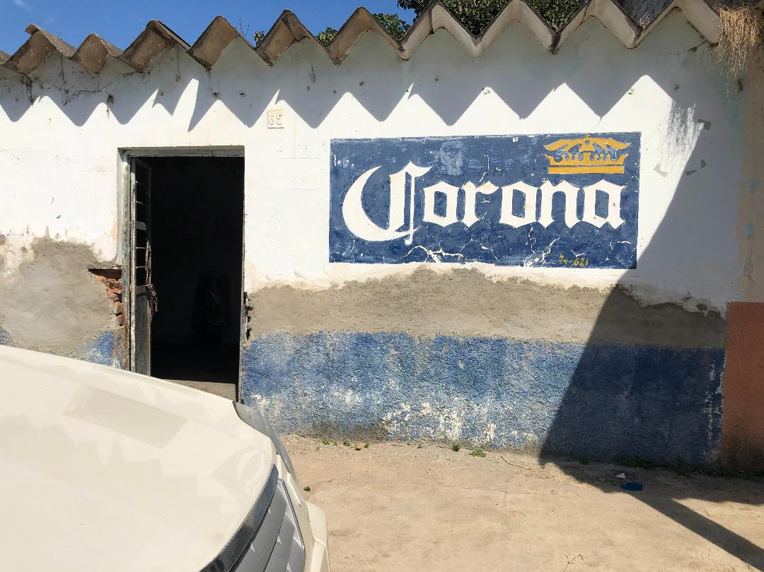
The Ejido has loaned this space permantly for the school

Slide 4
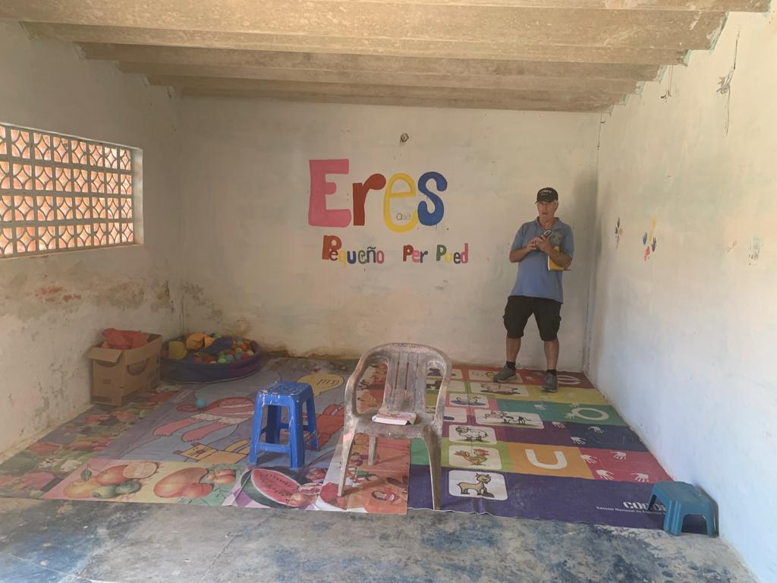
Not much.

Slide 5
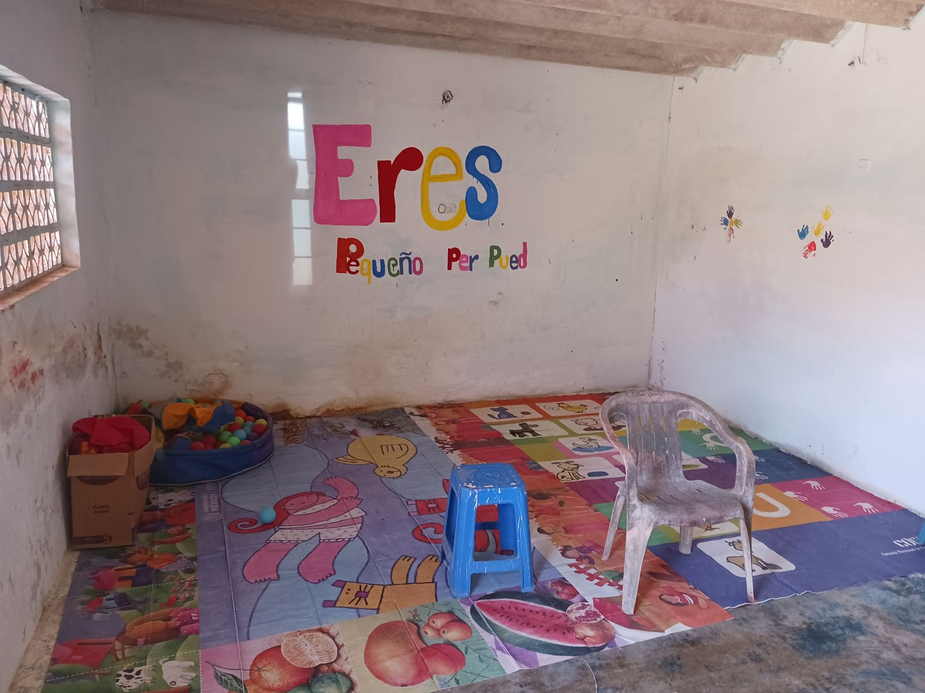
No chairs.

Slide 6
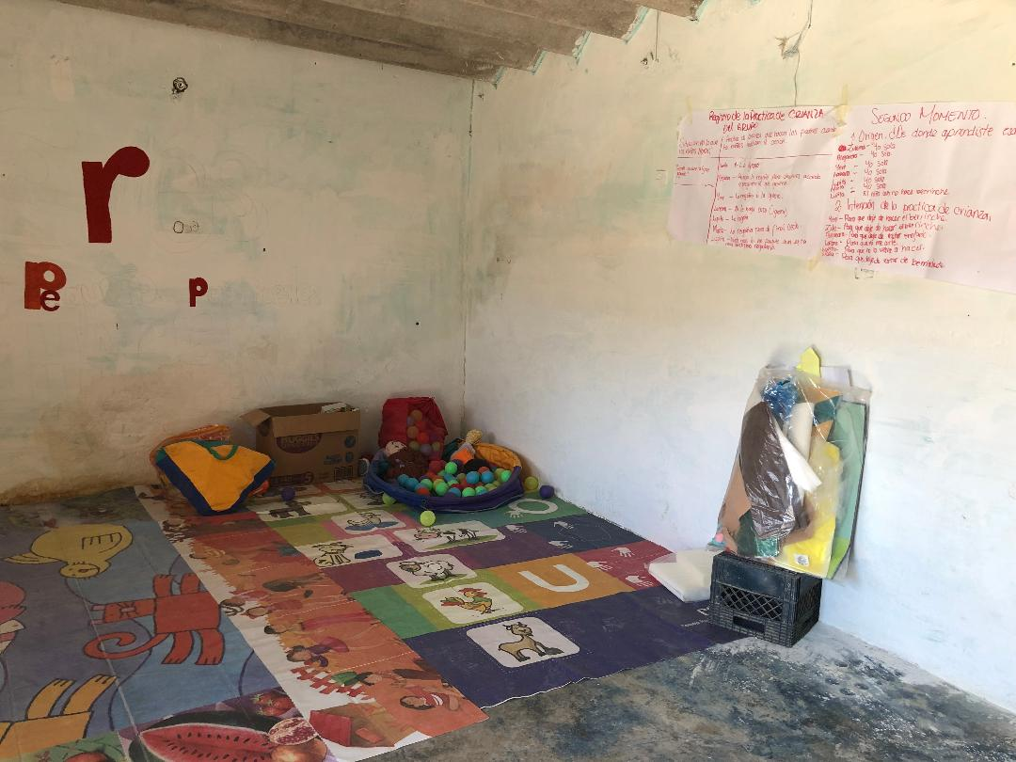
No tables.

Slide 7
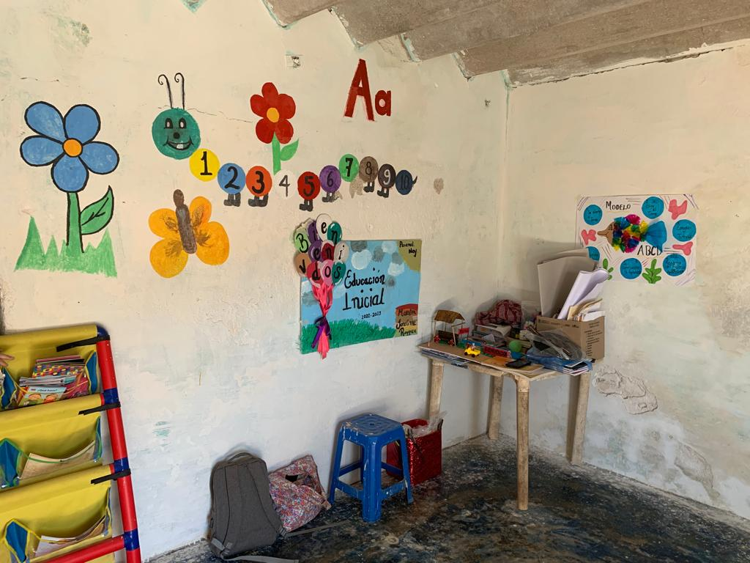
But a teacher with a great heart.

Slide 8
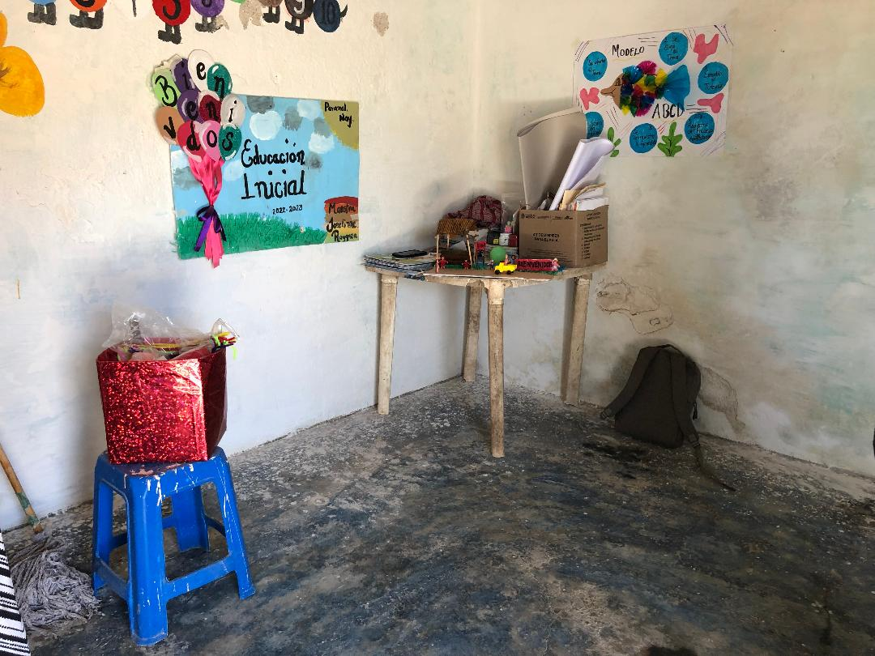
That does what she can to make it better.

Slide 9
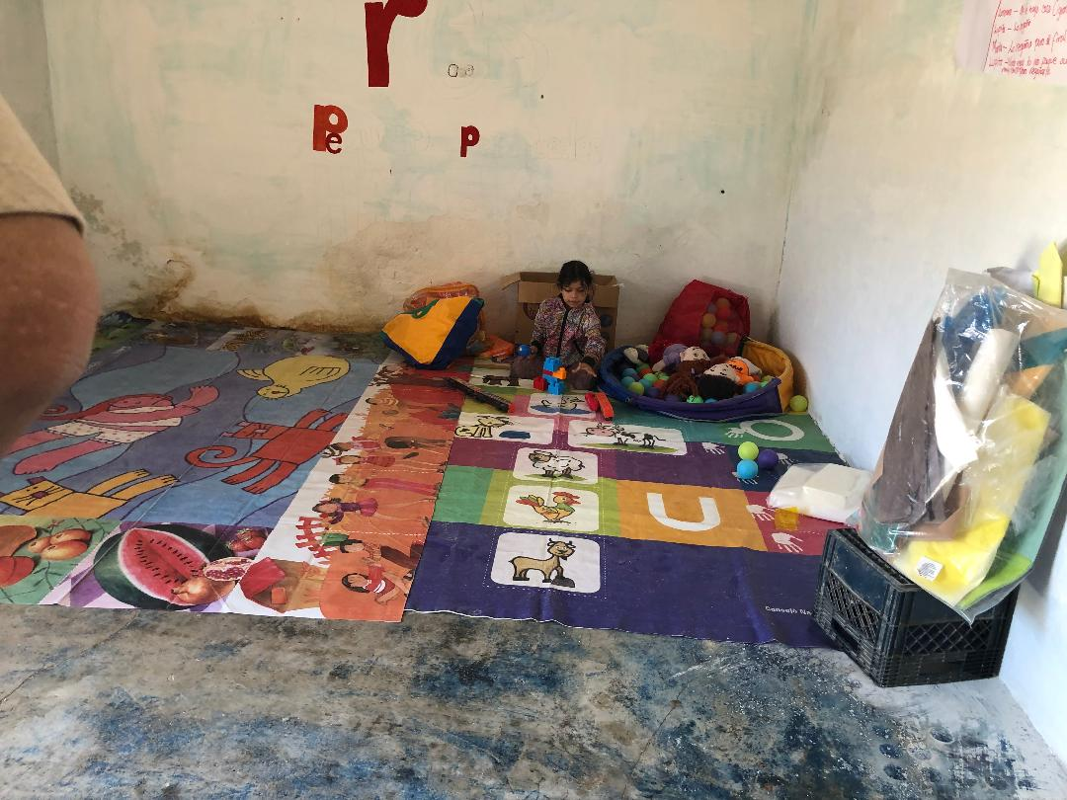
.

Slide 10
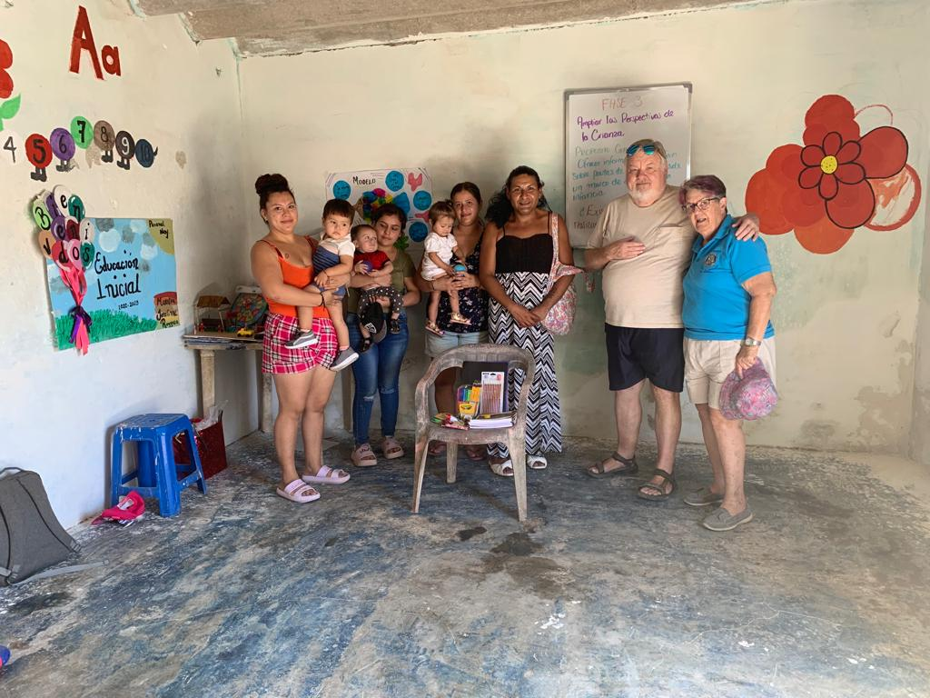
Here we are!

Slide 11
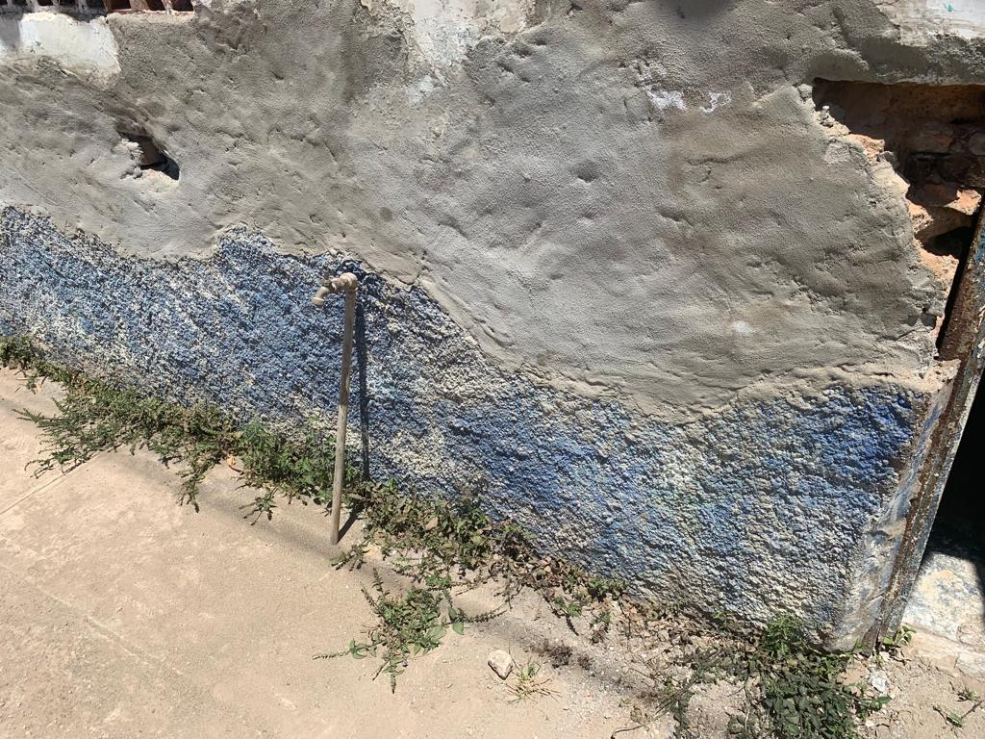
Water and Electricity is paid by the parents not the school system – CONAFE But they will do that!

Slide 12
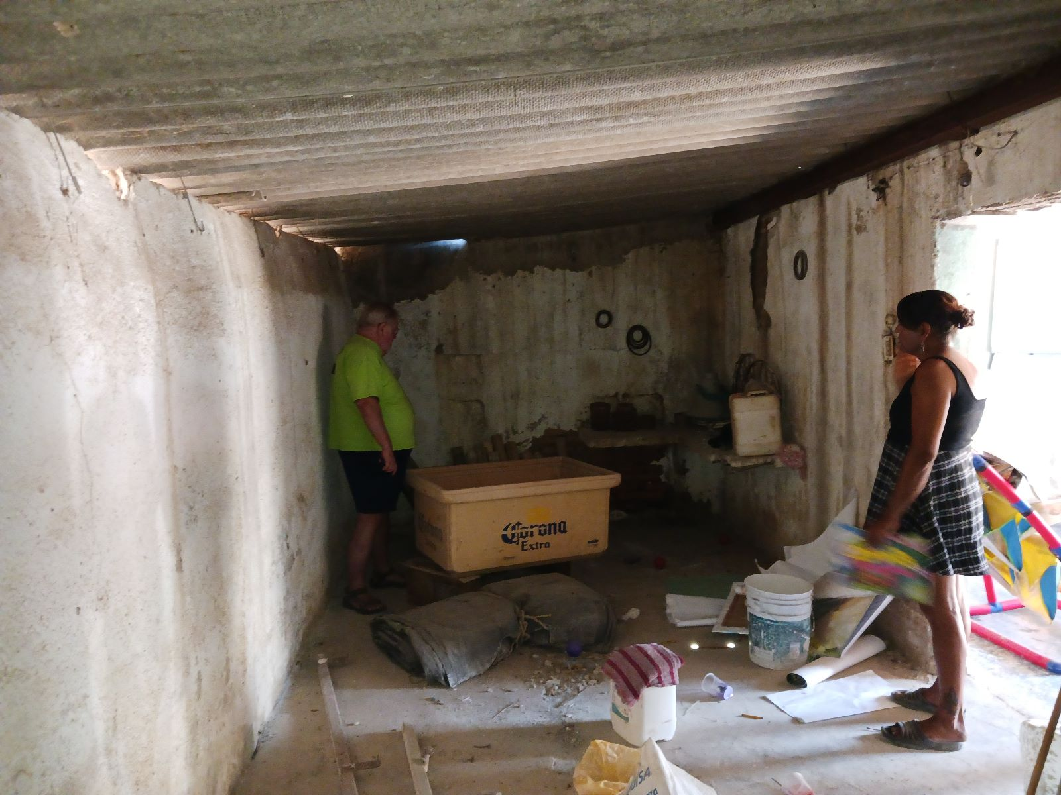
Looks worse than it is.

Slide 13
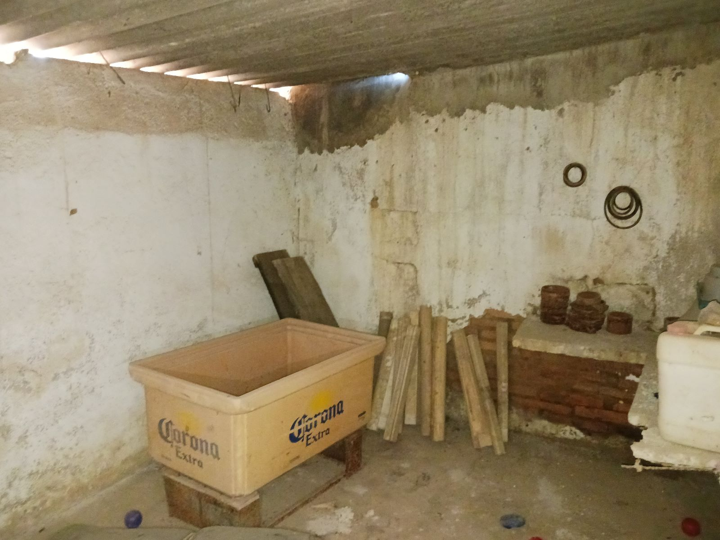
Bathrooms across this wall like these»»»

Slide 14
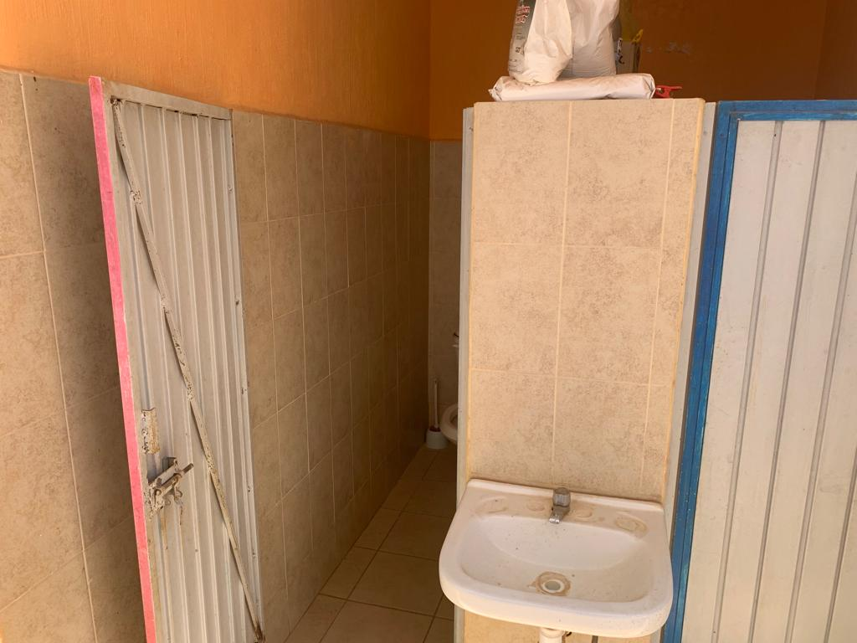
Two bathroom stalls like these two.

Slide 15
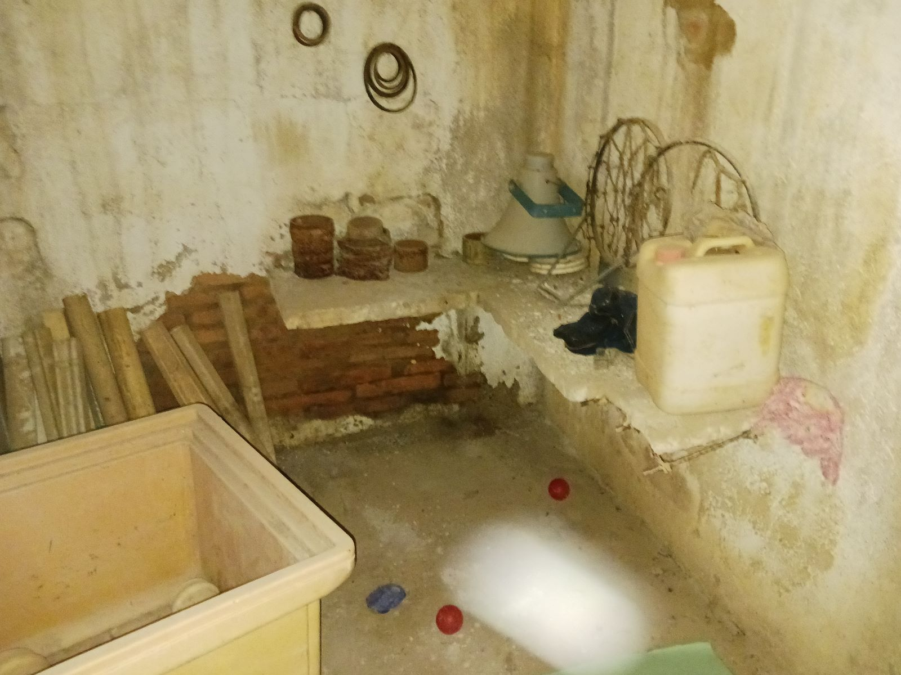
Some removal of old stuff.

Slide 16
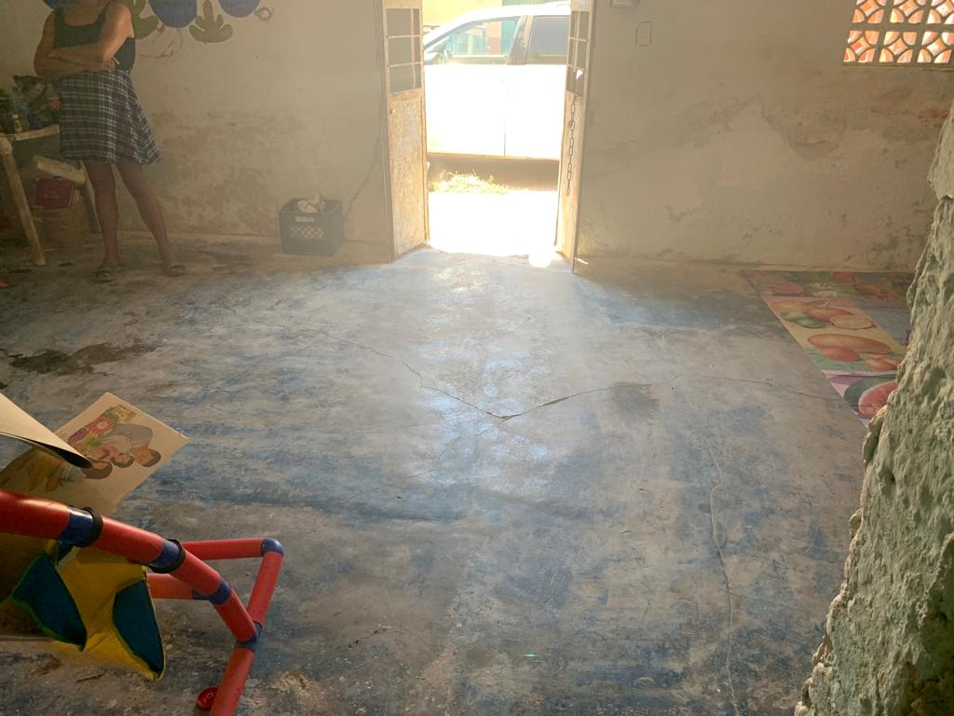
Cut the floor for water in and drain out.

Slide 17
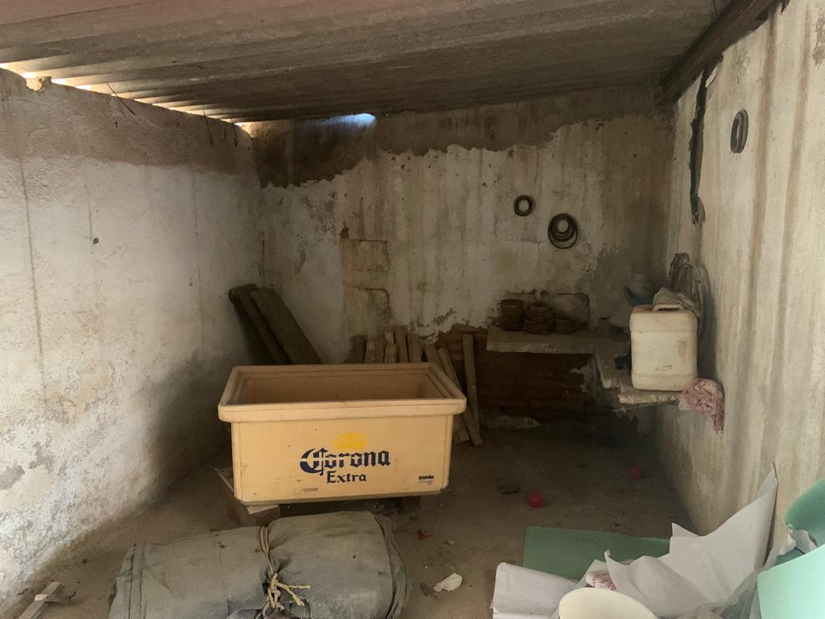
It will end up looking better than this!!

Slide 18
Paranal
Worth the fix! Or maybe buy some chairs.
We are in the process of getting a cost summary because this one is new to us. If interested please let us know and we will respond. Contact: Vern Porter – vernporter@yahoo.com

