Slide 1
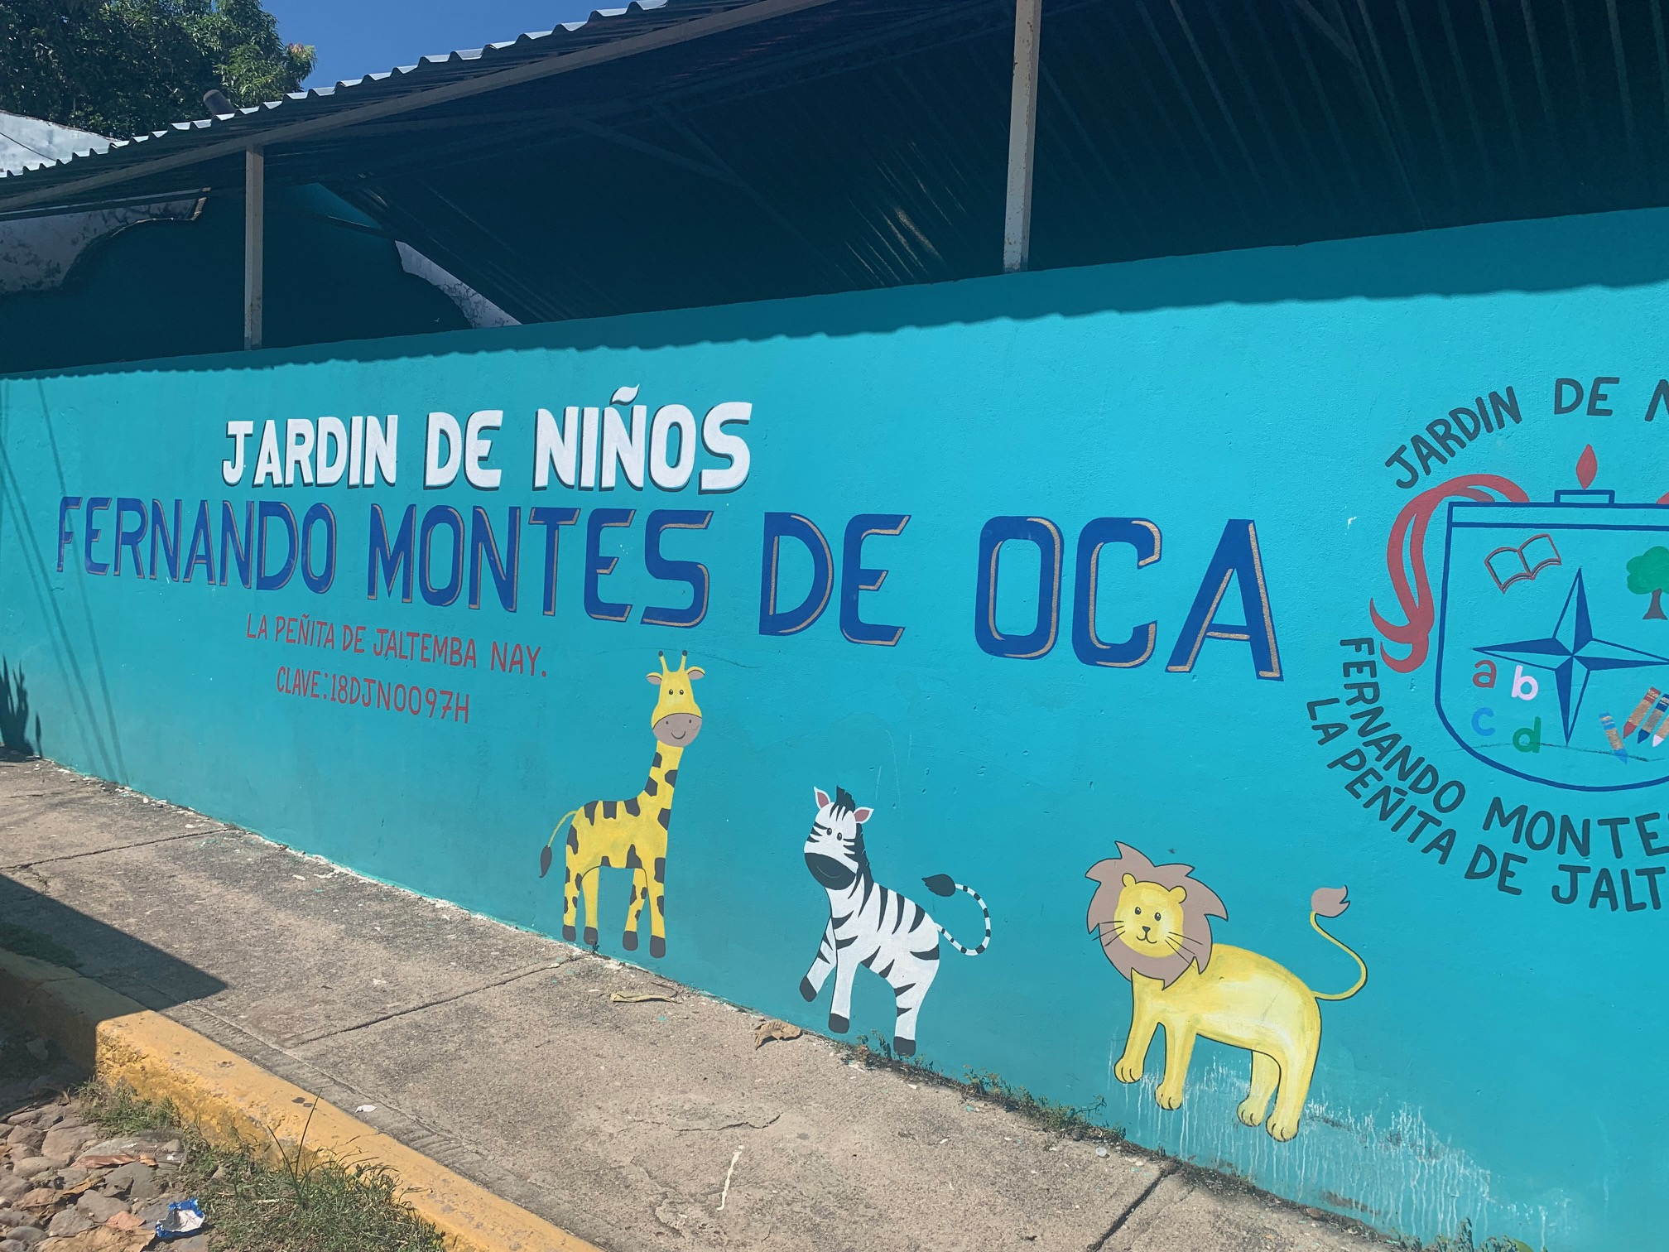
Classroom For Special Education

Slide 2
Why Is This Needed?
The need to build a special education classroom in the "Fernando Montes de Oca" kindergarten in the town of La Penita de Jaltemba arose three years ago when the special education service was opened, which cares for children with disabilities and/or barriers for learning and participation.

Slide 3
Here Is More Of The Reason
Each school year the number of students served has oscillated between 20 and 24 children, this department attends students with learning problems, attention deficit, language problems, autism, and students with hearing disabilities.

Slide 4
Sometimes A Low Noise Private Space Is Needed
A special education teacher, a language teacher and a psychologist attends students with learning problems, attention deficit, language problems, autism, and students with hearing disabilities. This happens in the playground. They have no space of their own.

Slide 5
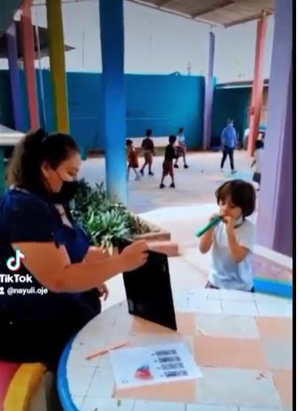
Classroom In The Playground

Slide 6
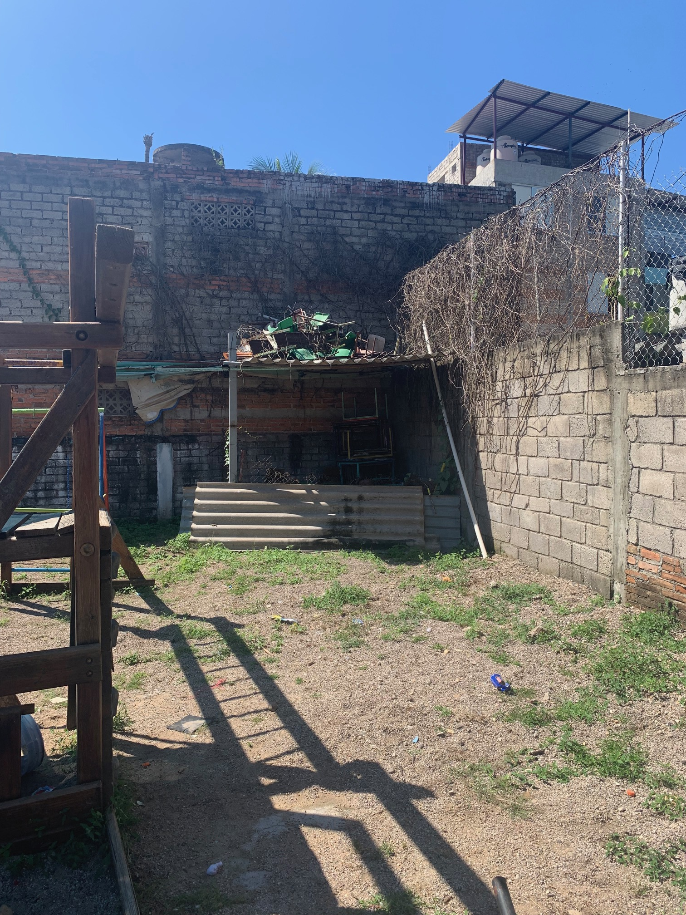
One Little Corner Of The World

Slide 7
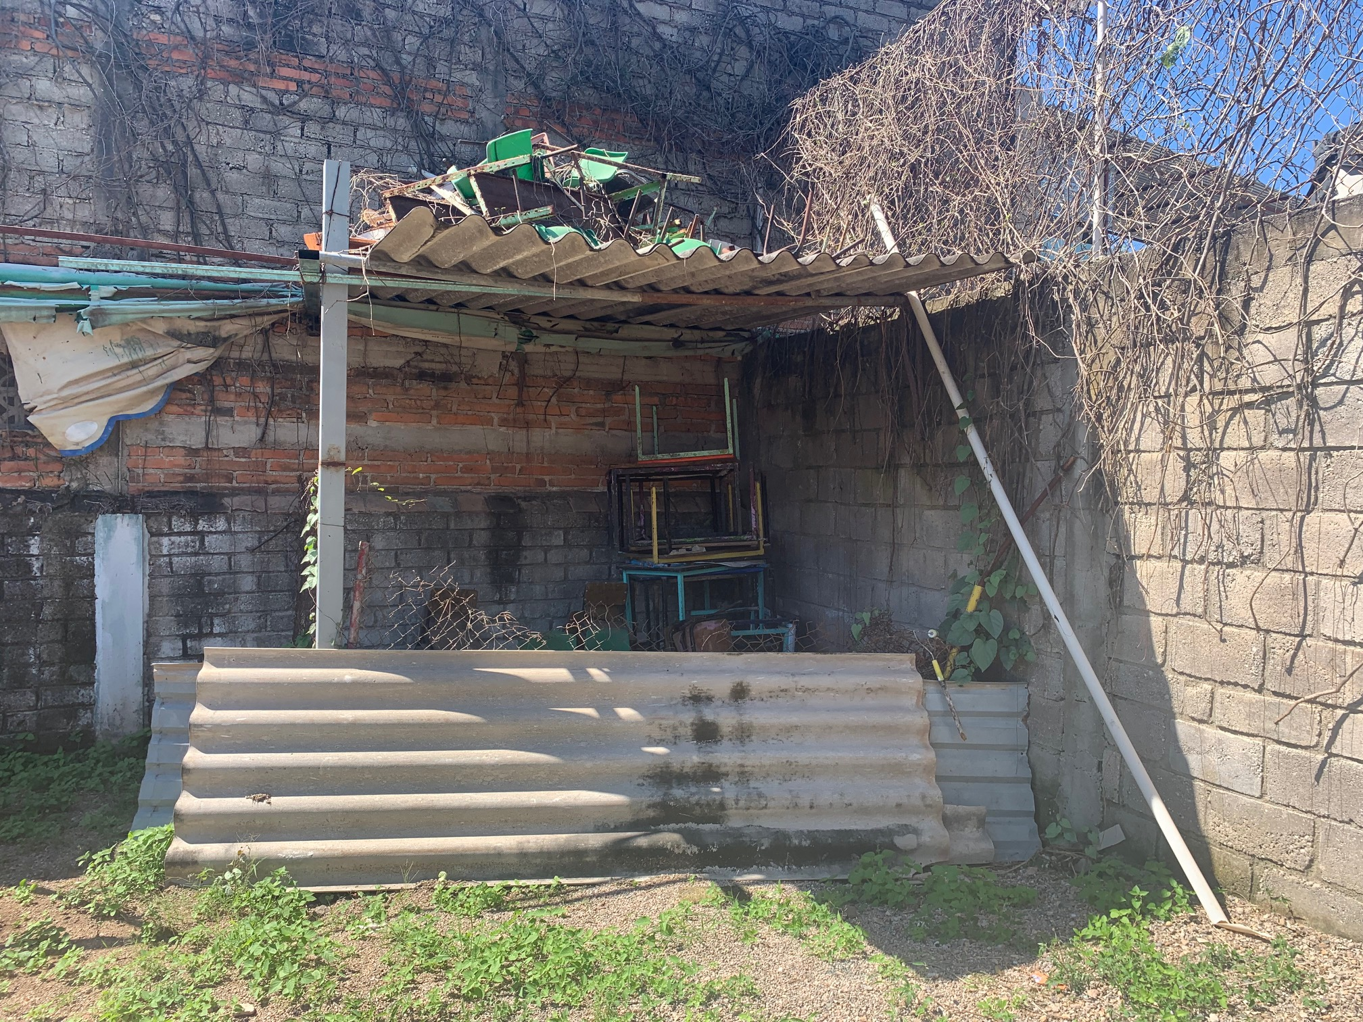
This is the space for a classroom.

Slide 8
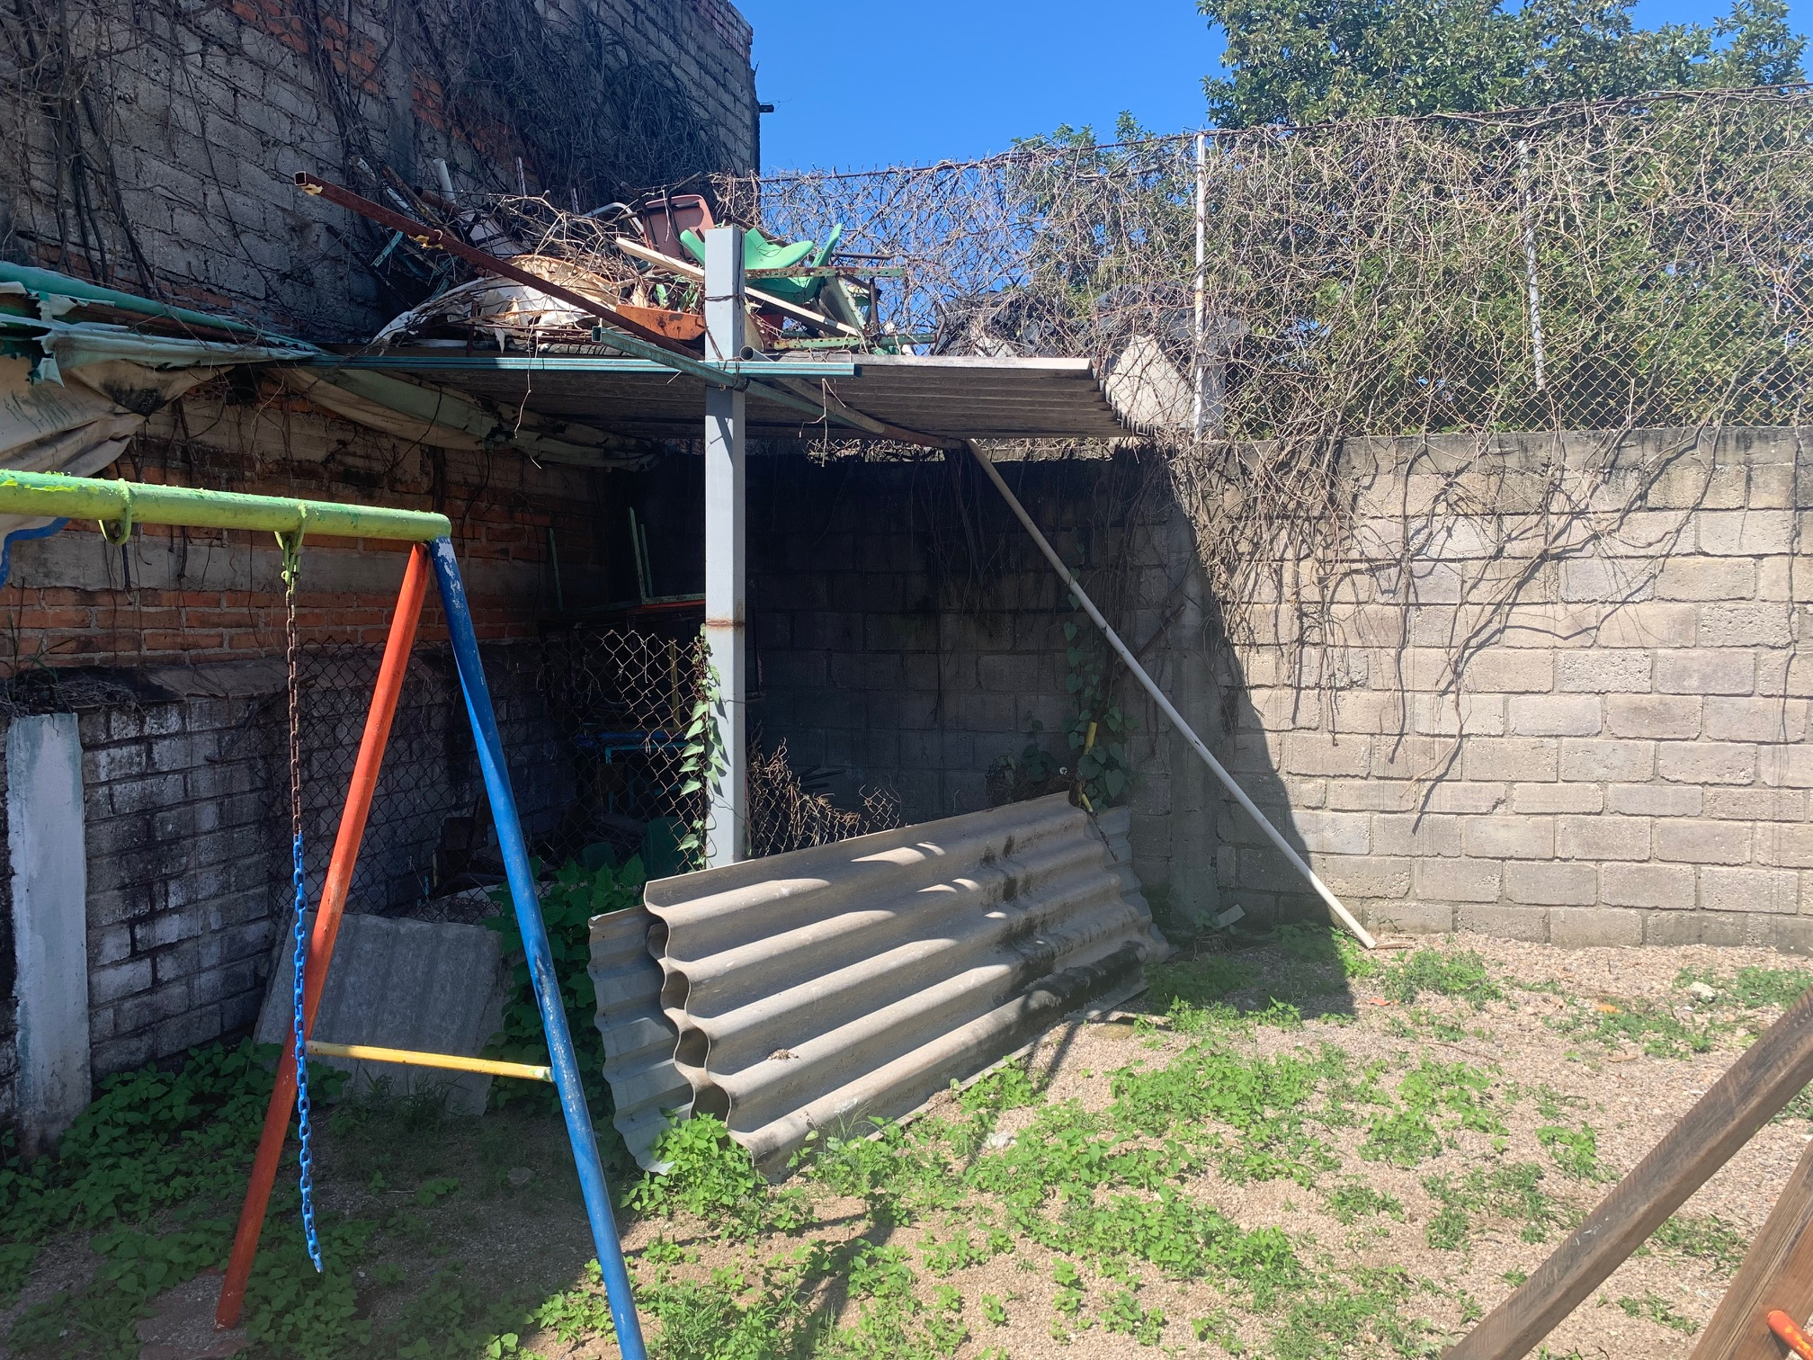

Slide 9
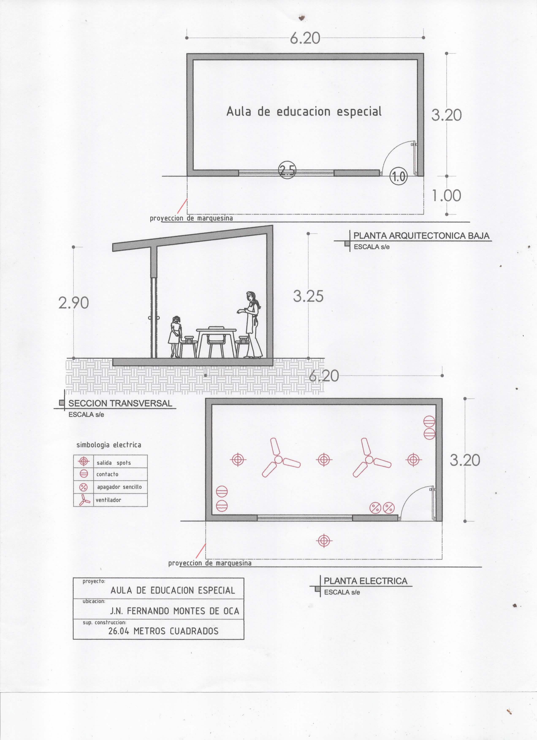
Classroom
Design
Electrical/Hydo Wiring Diagram

Slide 10
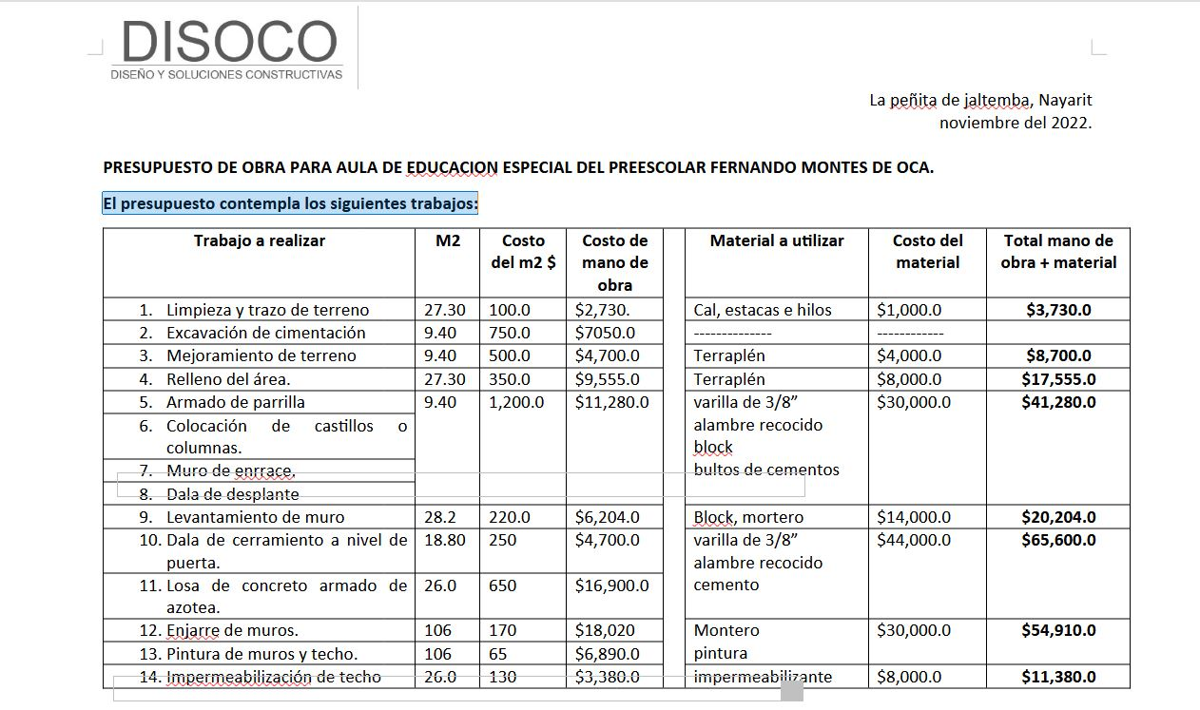
Cost To Construct – Best Guess For Now- Page 1

Slide 11
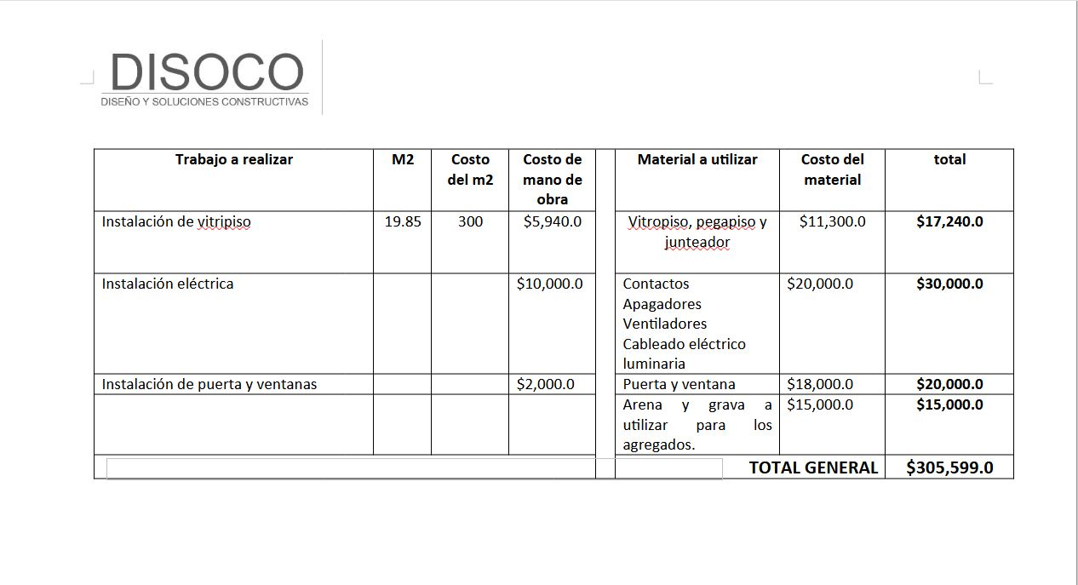
305,599p = 15,753usd / 21,031cad

Slide 12
A Great Project For Several Clubs Working Together
Reasons to do this project:
Would make a real difference for the students and teachers, espacially for the students
A chance to come to this beach town with other club members
Do a little work at the project
Contact: Vern Porter - vernporter@yahoo.com or Eddie Dominguez - echopk26@gmail.com
(Cost will have changed due to inflation and exchange rates)

