Slide 1

El Tonino School Fence Project
The following slides will show the condition of the walled fence around the kinder, that includes grades 1 to 3 in El Tonino plus the estimated cost to replace it. El Tonino is about ½ hour from downtown La Peñita.

Slide 2
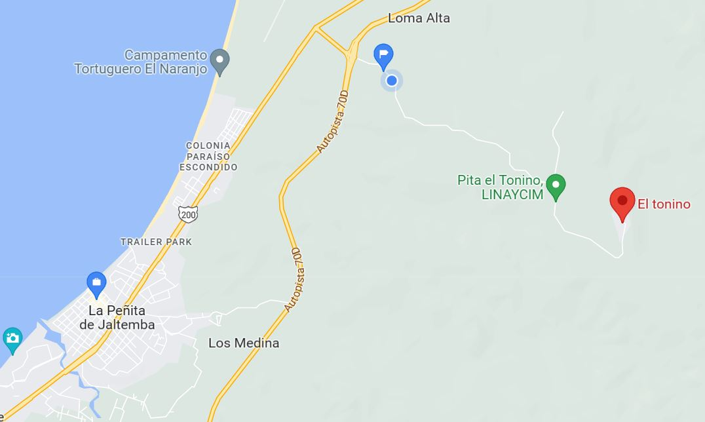
LOCATION OF EL TONINO

Slide 3
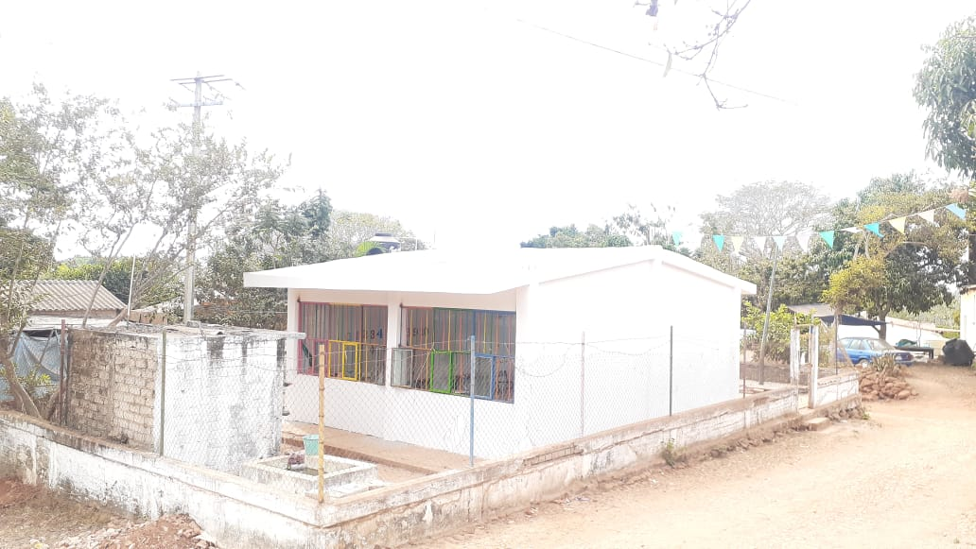
THE COMMUNITY PUT IN THEIR PART TO FIX THE BULDING AND WILL DO THE SAME FOR THE FENCE.

Slide 4
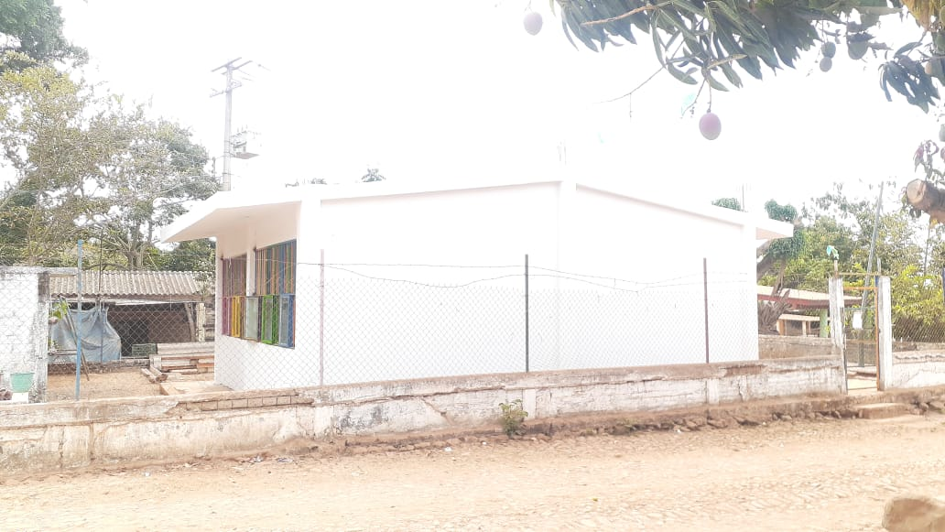

Slide 5
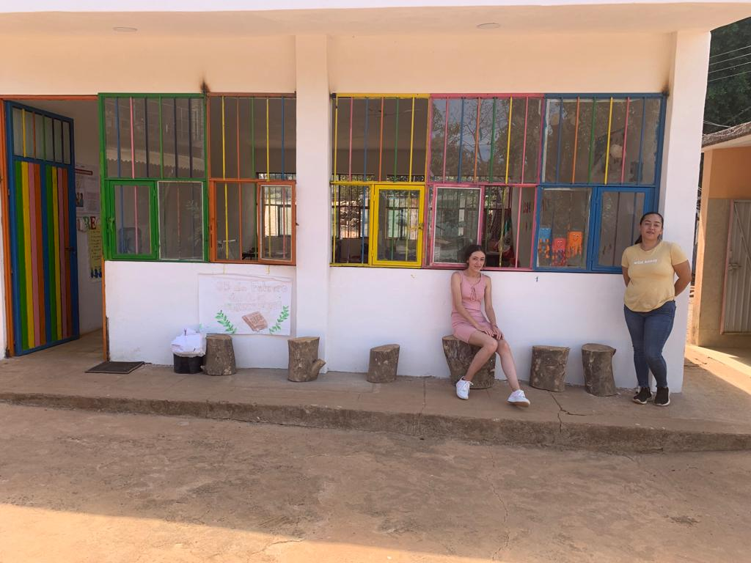
Supervisor-Nayele Gomez with teacher Alejandra Ocampo

Slide 6
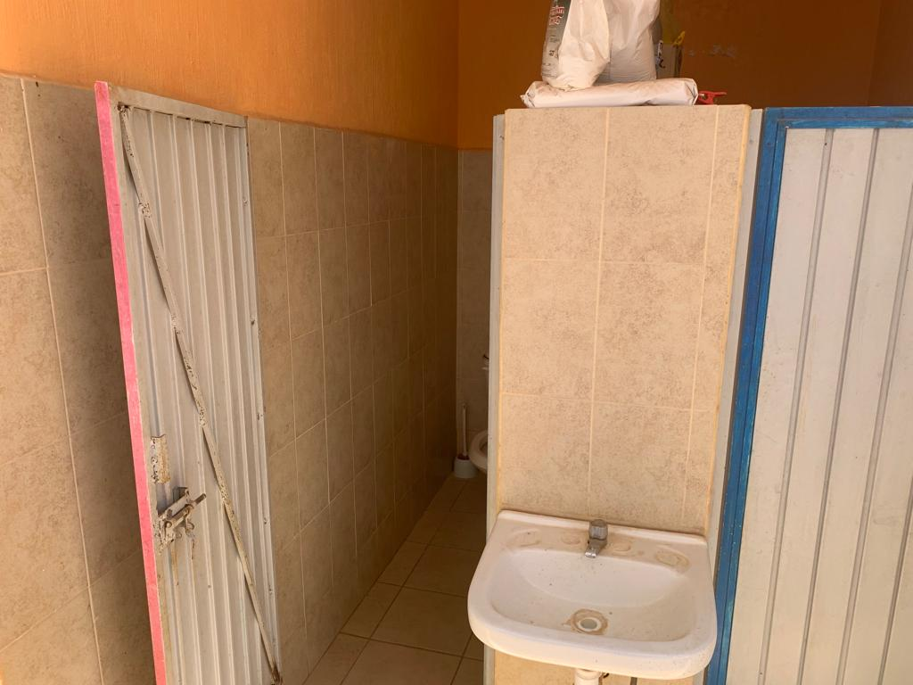

Slide 7
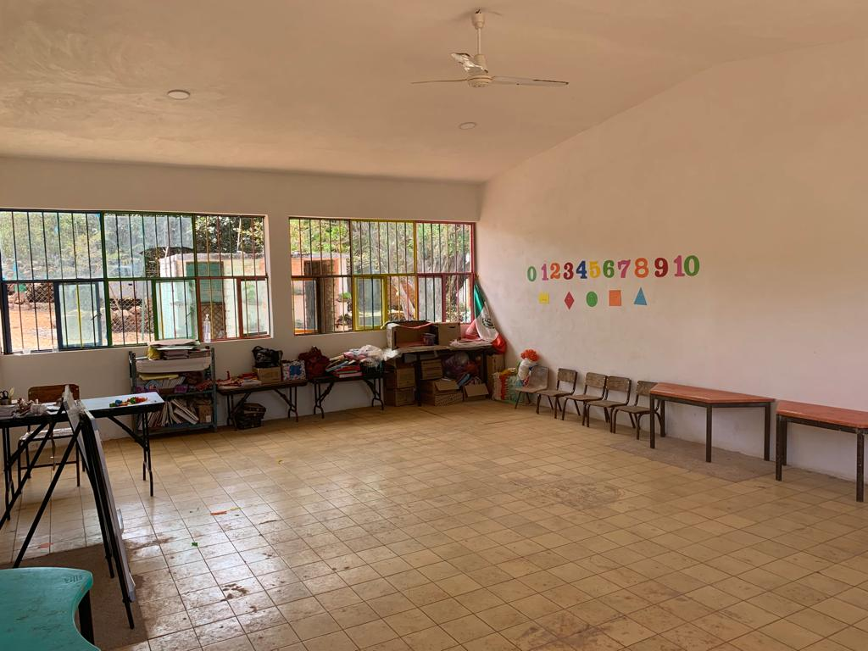

Slide 8
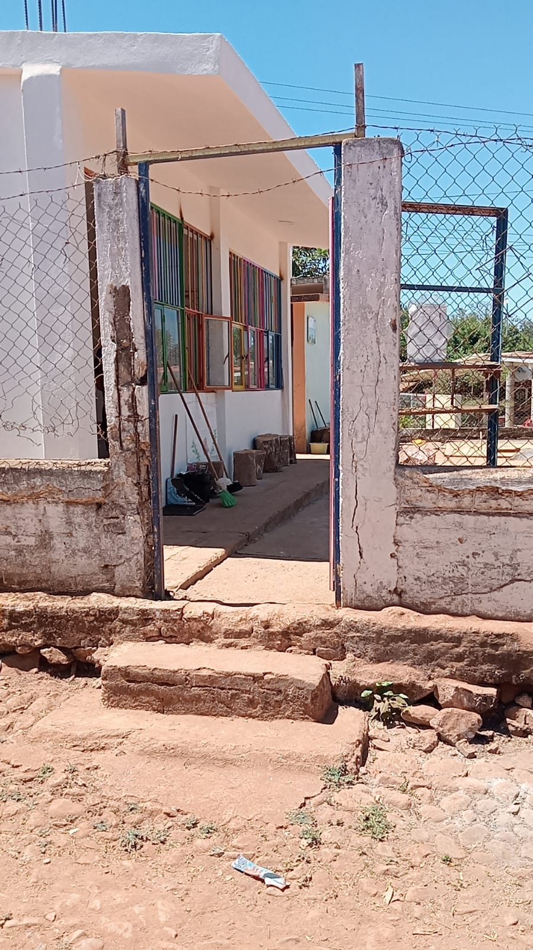
FENCE OF 64 METERS IS FALLING DOWN ALL AROUND THE SCHOOL

Slide 9
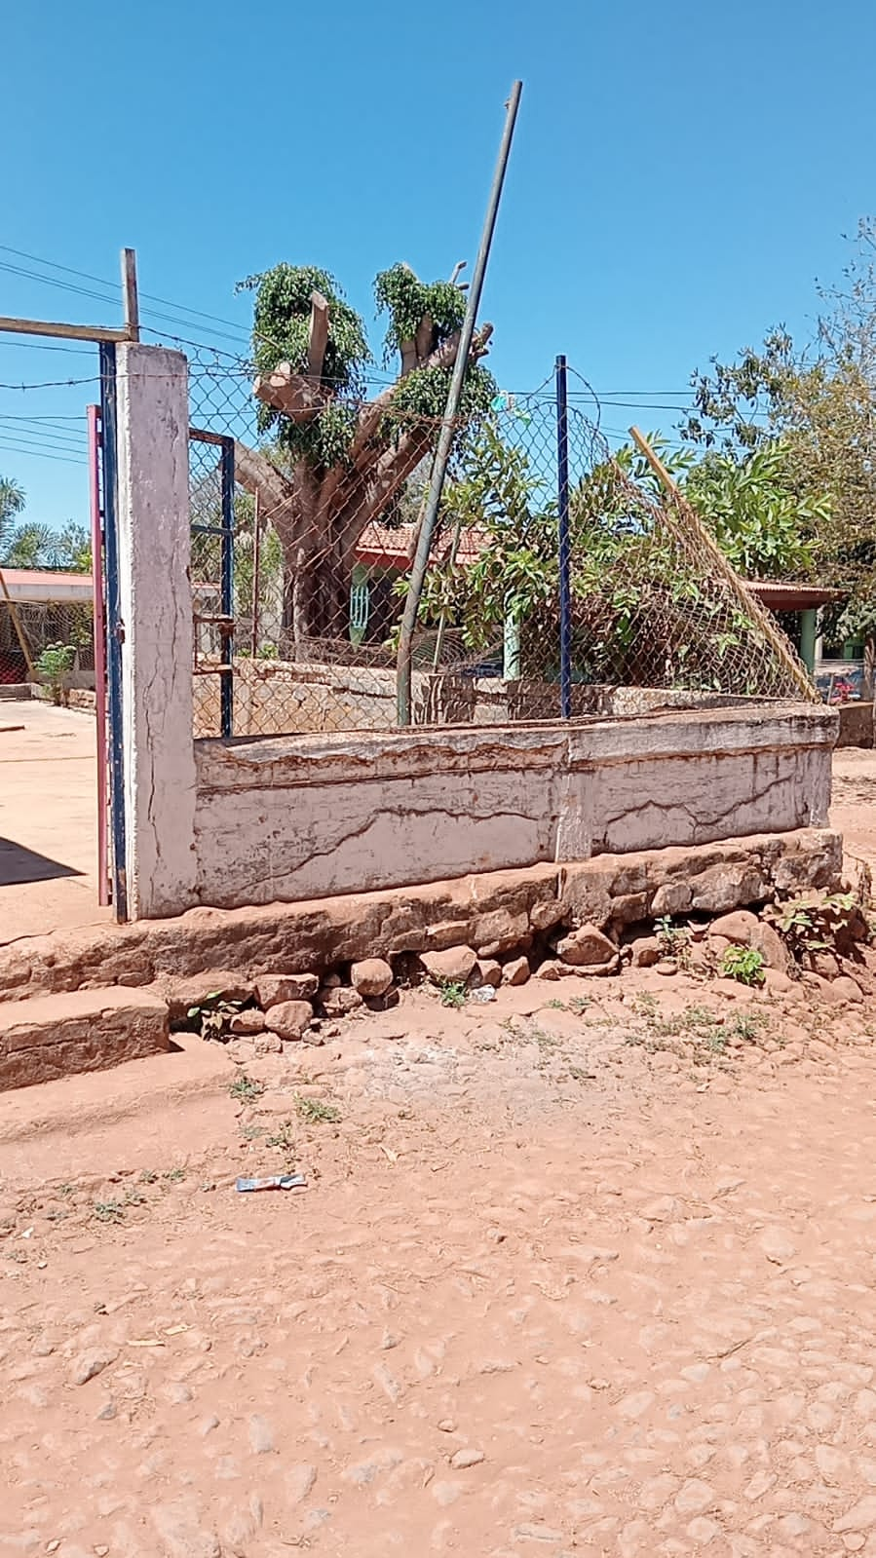

Slide 10
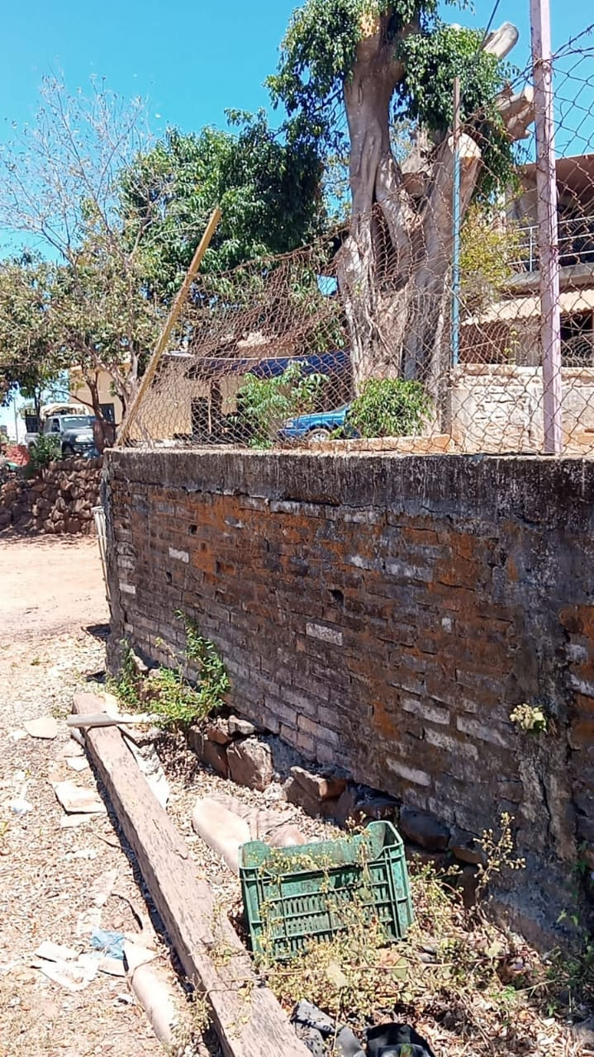

Slide 11
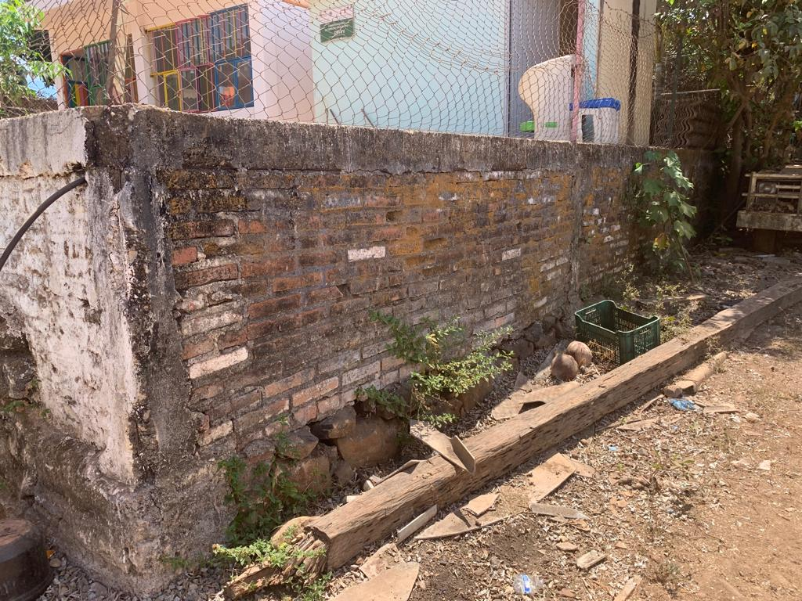

Slide 12
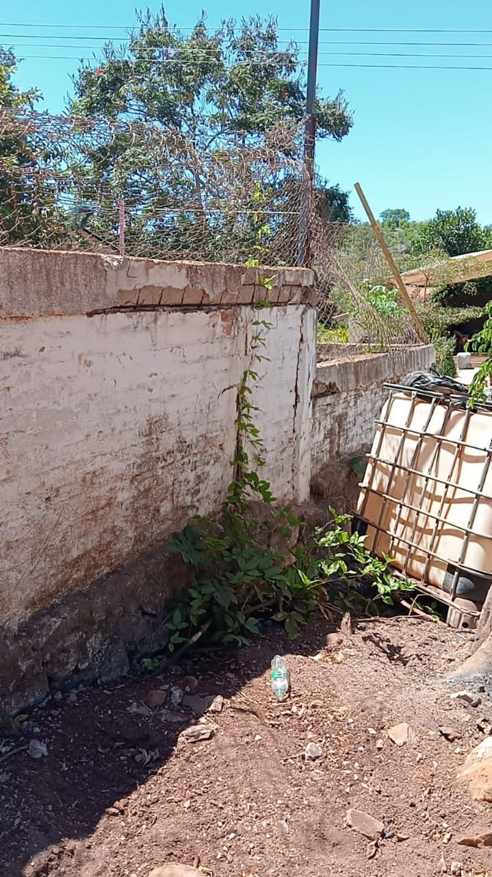

Slide 13
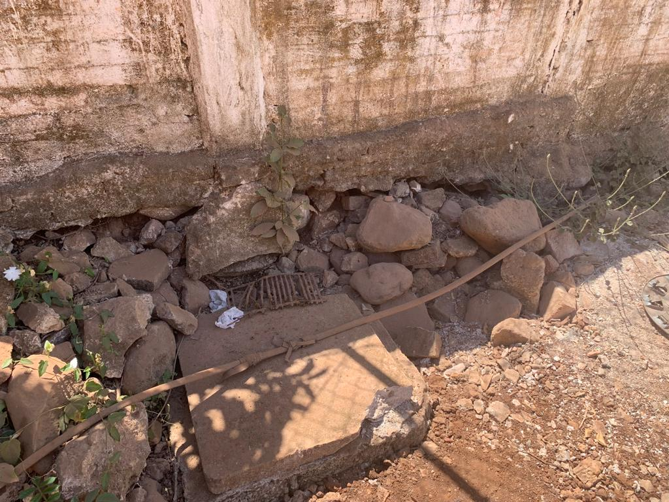
The base or the foundation is the problem.

Slide 14
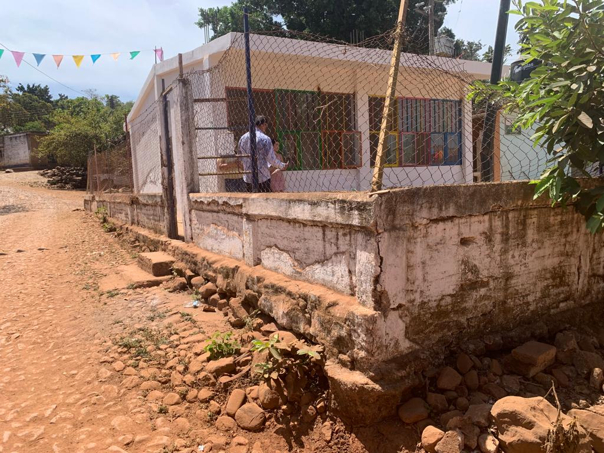

Slide 15
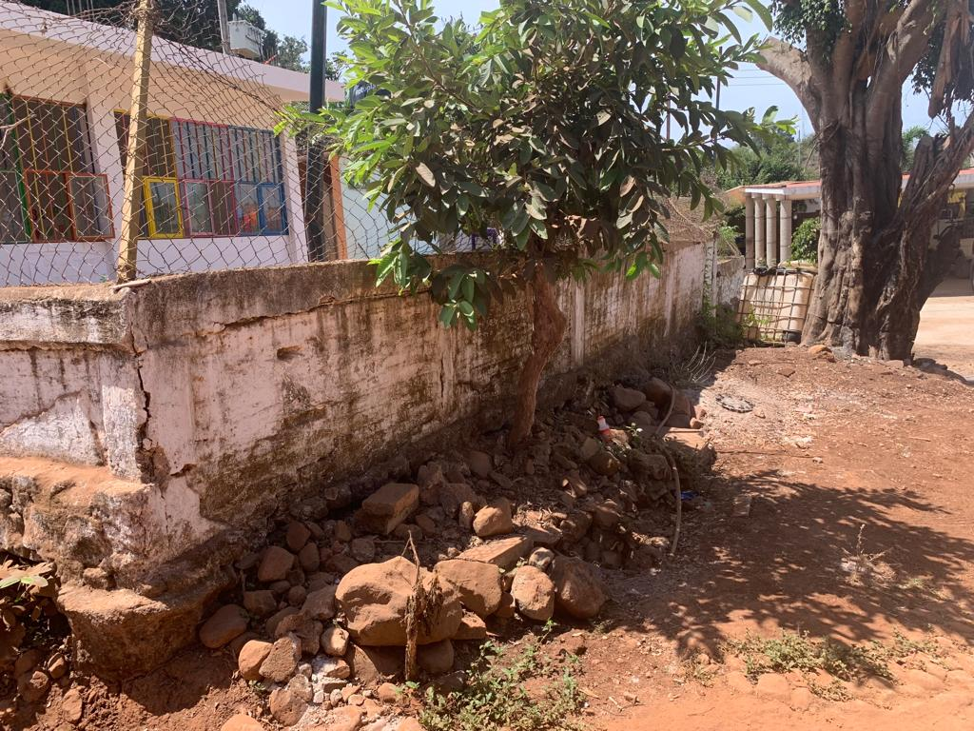

Slide 16
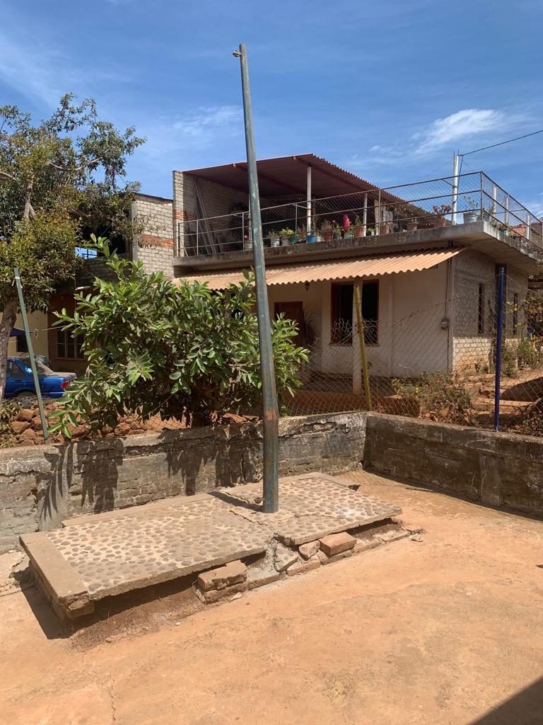

Slide 17
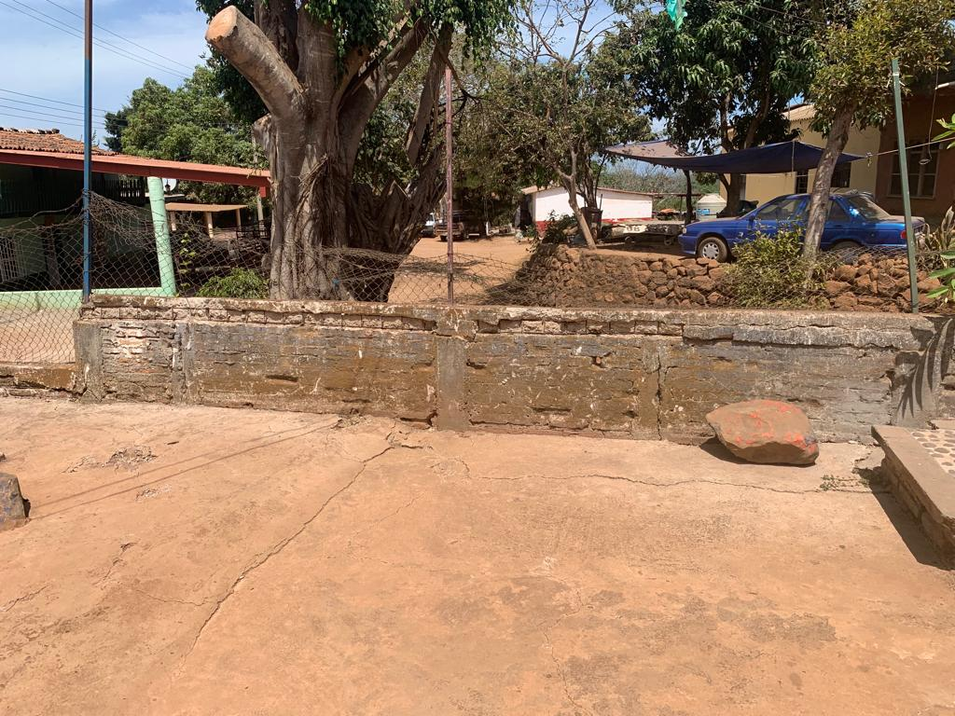

Slide 18
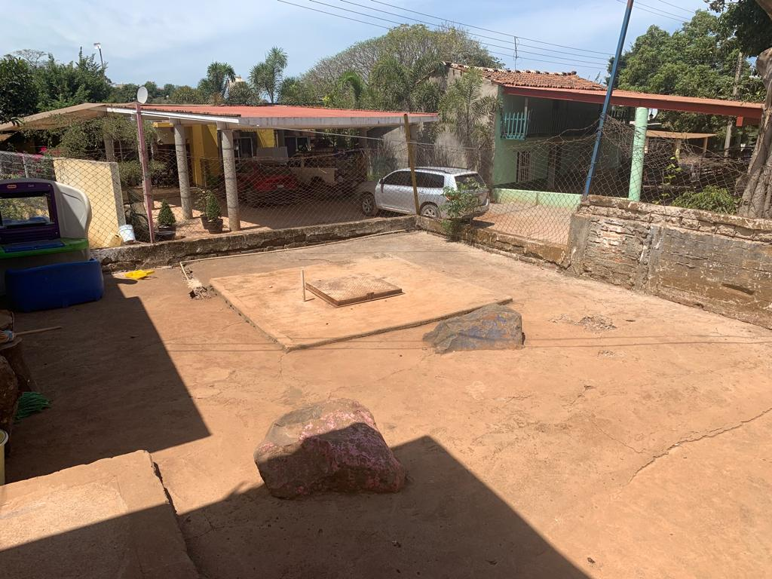
The base moves with the rain and causes the cistern to leak.

Slide 19
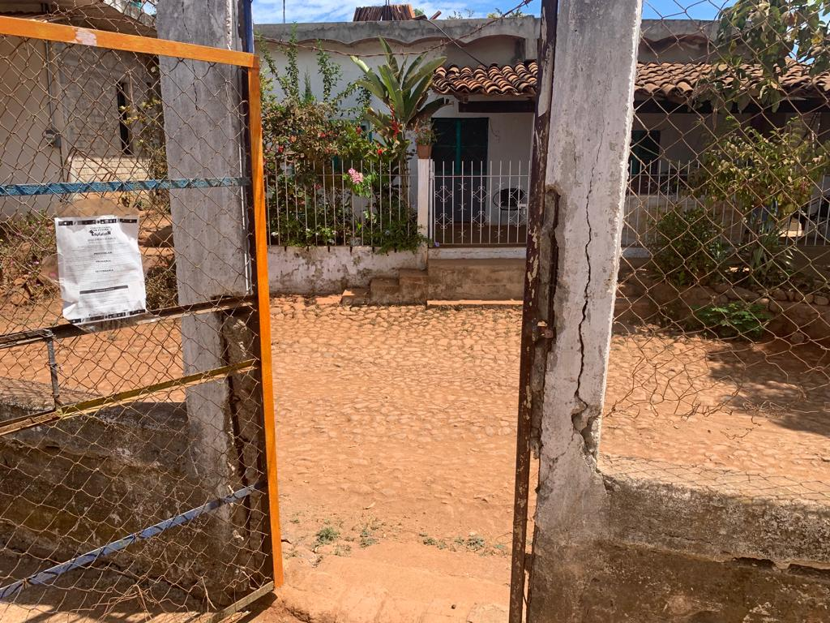

Slide 20
El Tonino School Fence Project
TOTAL DE MANO DE OBRA (LABOR)
$115,000 The town folks have agreed to contribute $50, 000 pesos in labor for this project.
TOTAL PROJECT COST
$256,760
MINUS TOWN LABOR
$50,000
TOTAL
$206,760
Ask for supporting word document “El Tonino Fence” for details. Contact: Vern Porter – vernporter@yahoo.com

