Slide 1
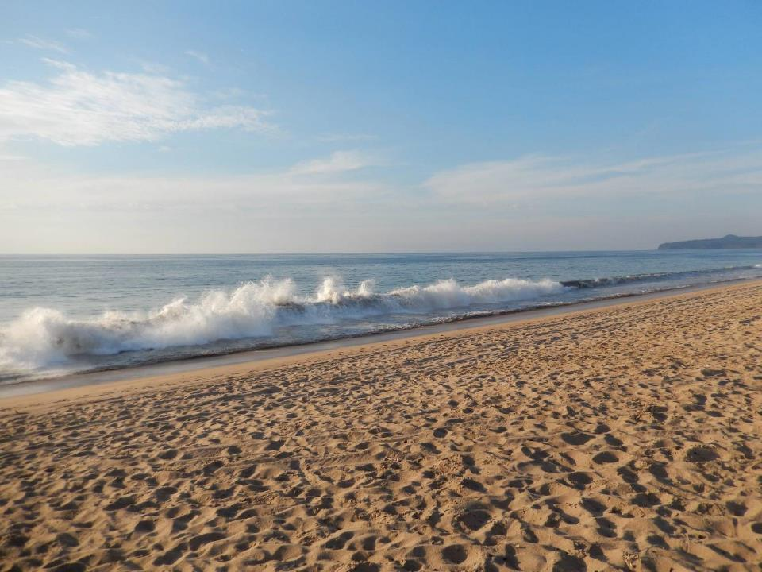
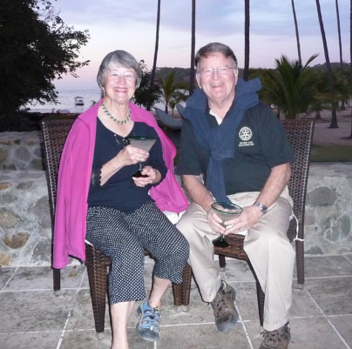

2003 - 2023
CHANGING LIVES in COASTAL NAYARIT
through EDUCATION
facilities improvements and support

Slide 2

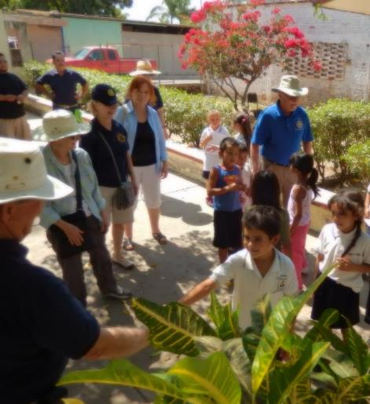
Humanitarian Projects ready to take one on?
Berkeley &
La Penita Rotary
20 years in Nayarit
Community projects
Supporting
EDUCATION

Slide 3

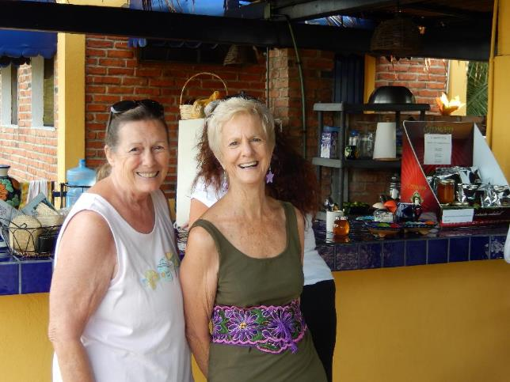
Educators
Community organizers
Marianna
Suzanna

Slide 4
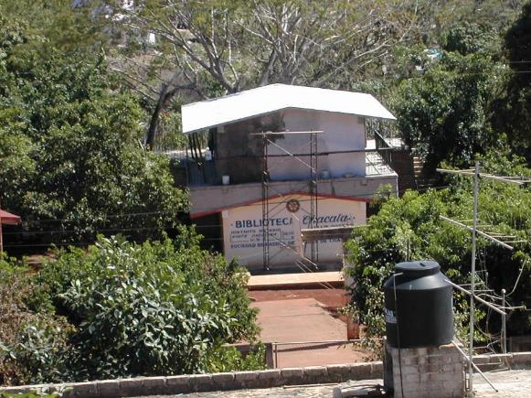
Humanitarian Projects
CHACALA 2003 - 2005

Slide 5

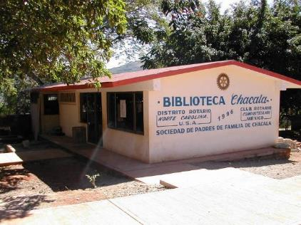
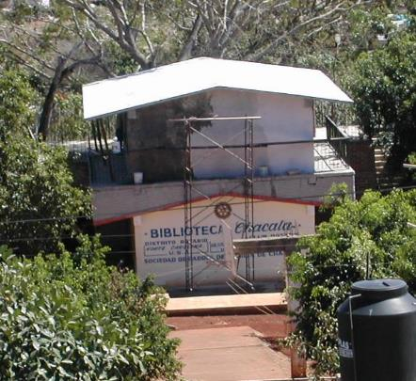
CHACALA 2003 - 2005
Learning Center, Tool Library, Kitchen, Bathrooms,
Rehab - Kindergarten, Elementary School classrooms

Slide 6


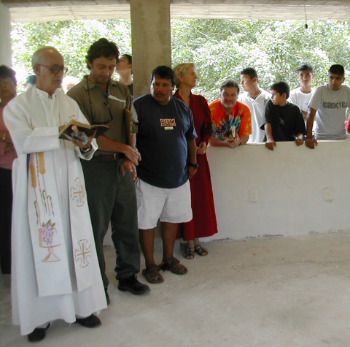
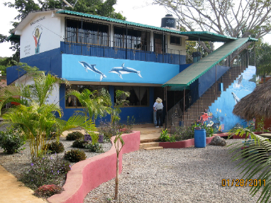
Blessing the
Learning Center

Slide 7
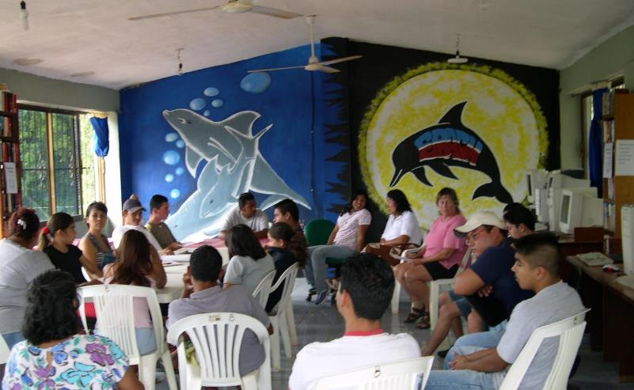
It’s what happens afterwards

Slide 8

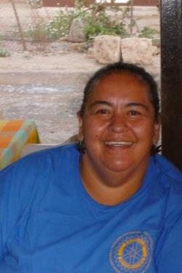
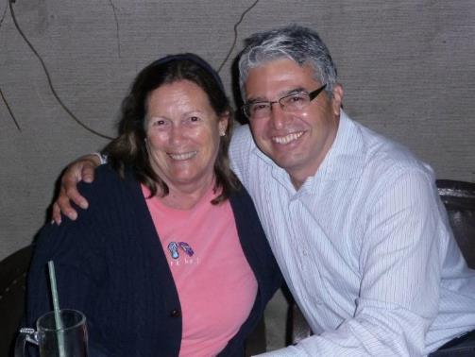
Humanitarian Projects:
Local leaders involved
Vicky Marianna Eddie

Slide 9
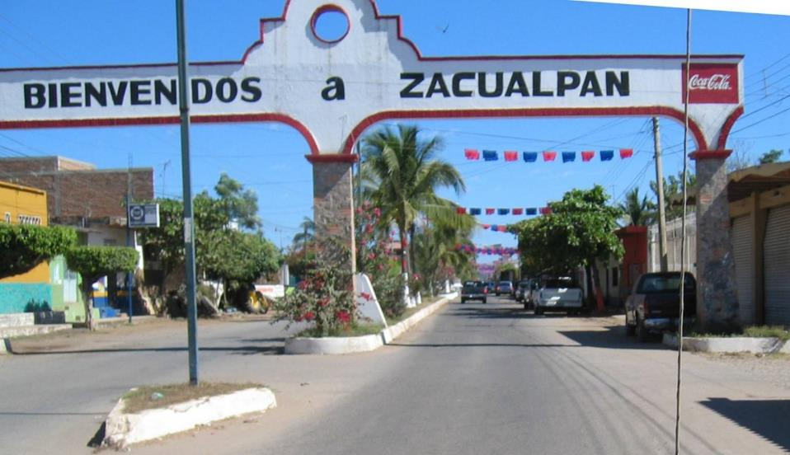
2011 HIGH SCHOOL REHAB

Slide 10
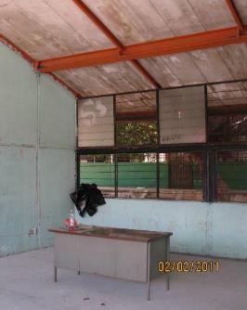
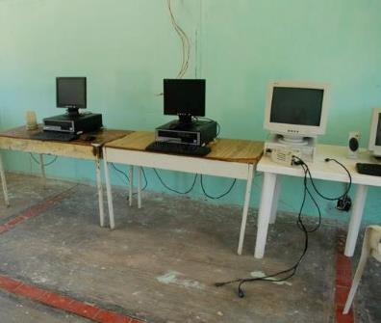
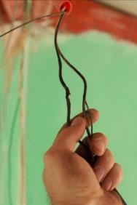
ZACUALPAN 2011
Our first joint project
Before
La Penita, Middletown, Berkeley Global Grant
Roofing, Computer desks, Tile floors,
Electrical wiring, Painting, Culinary Lab

Slide 11
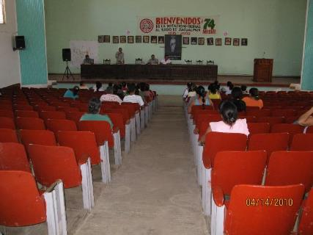
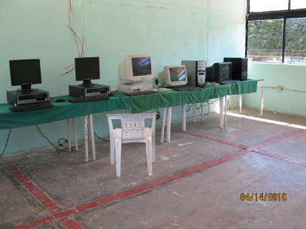
Zacaulpan
Tribal council accepts the project
Tribal Council Existing Computer lab

Slide 12
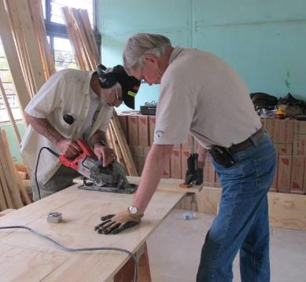
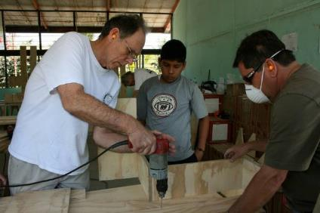
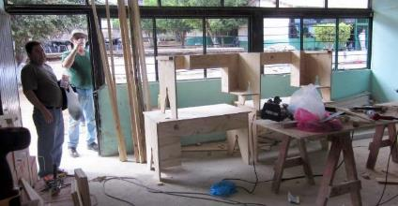
Humanitarian Projects:
Hands-on within your capabilities
Carpentry, Painting, Tile – Building
Computer Desks

Slide 13

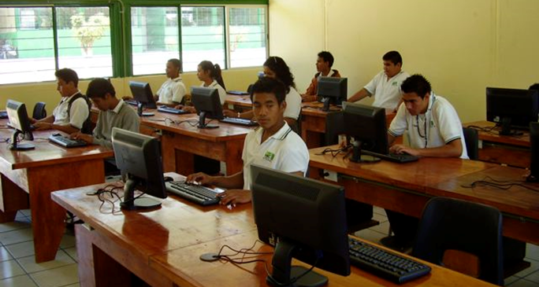
Zacaulpan
Compute lab in use

Slide 14
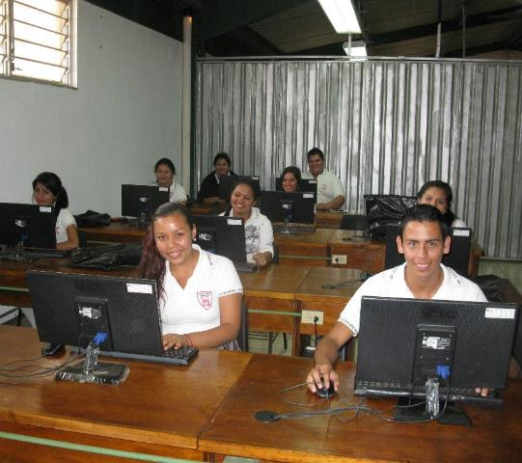
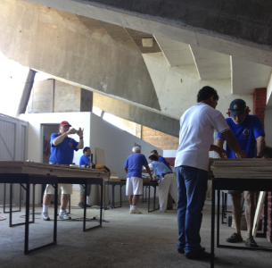
La Penita – CONALEP 2012
Computer lab

Slide 15
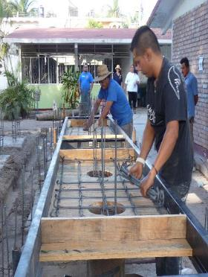
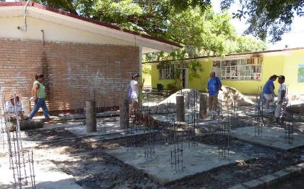
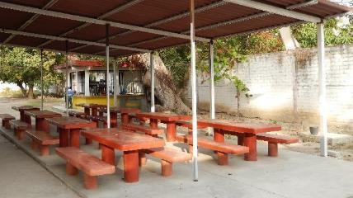
La Penita – Primary School 2012
CONCRETE
LUNCH TABLES &
BENCHES

Slide 16
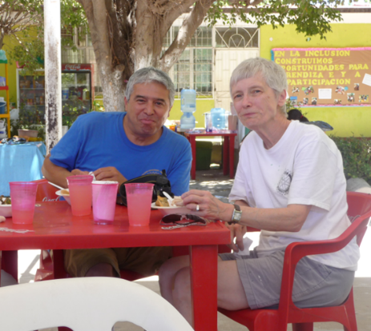
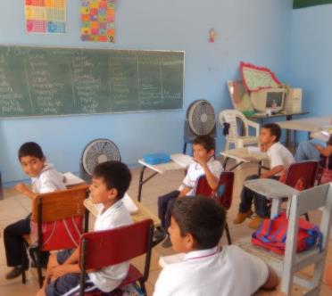
La Penita – Primary School 2012
LEARNING & VOLUNTEERS at LUNCH

Slide 17
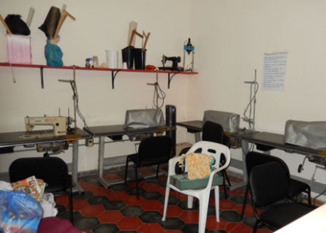
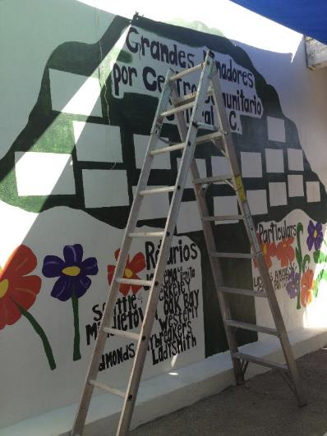
La Penita –Community Center 2012
SEWING ROOM
PAINTING
RECOGNITIONS

Slide 18
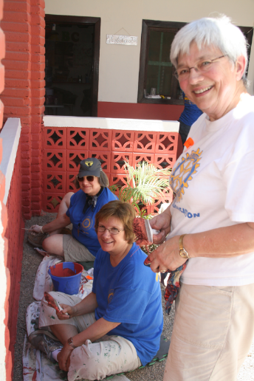
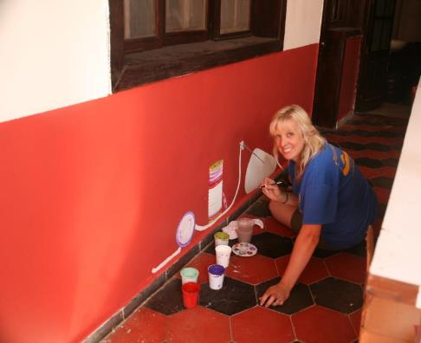
La Penita –Community Center 2012
Volunteers at work

Slide 19
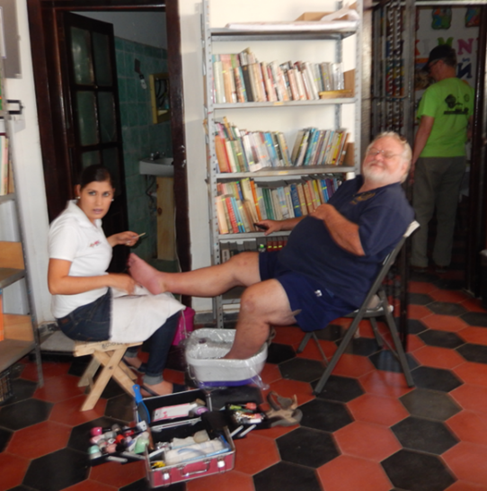
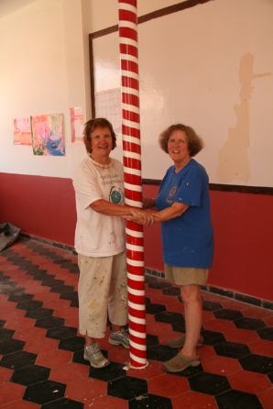
La Penita –Community Center 2012
Volunteers at Work

Slide 20
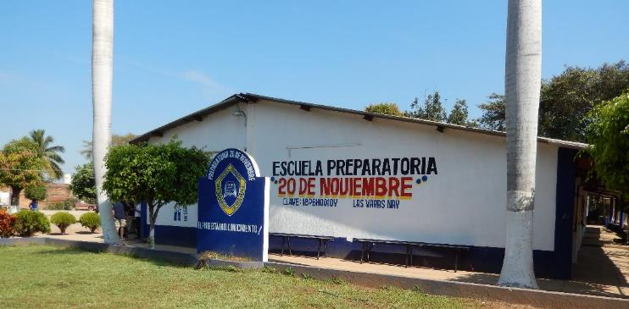
LA PREPA HIGH SCHOOL 2015 – 2017+
Las Varas Global Grant
Science Lab & equipment
Culinary lab – Teaching kitchen
Computer lab & equipment & Training

Slide 21
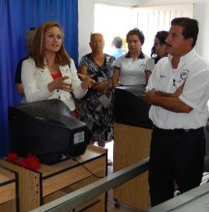
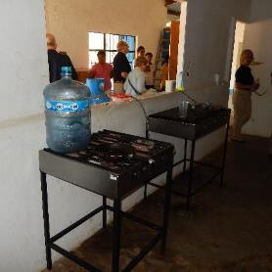
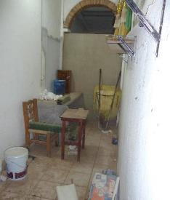
Humanitarian Projects:
2015 La Prepa High School
E
X
I
S
T
I
N
G
4 working
Computers
Culinary lab ?
Science lab ?

Slide 22
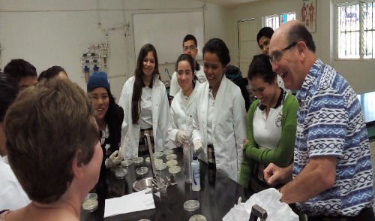
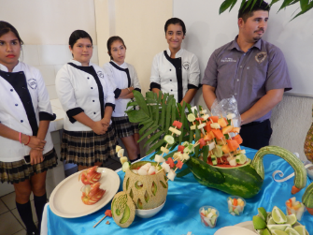
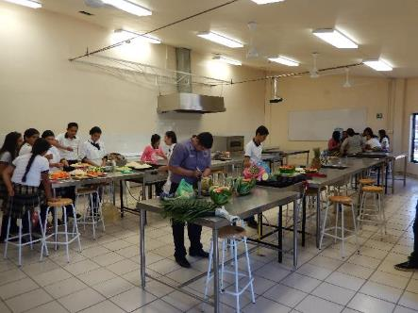
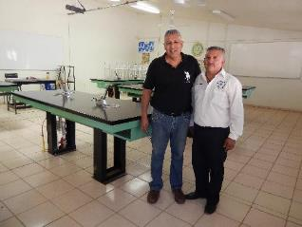
La Prepa Science & Culinary Labs
20+ stations each lab

Slide 23
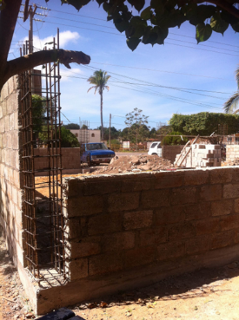
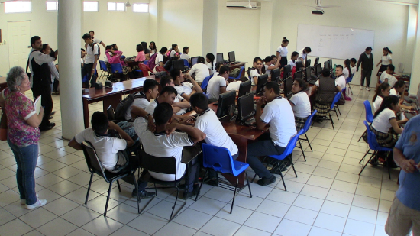
La Prepa Computer Lab
Two years of teacher training
Using technology in teaching
Community built the building
Rotary finished it & equipped it

Slide 24
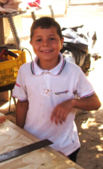
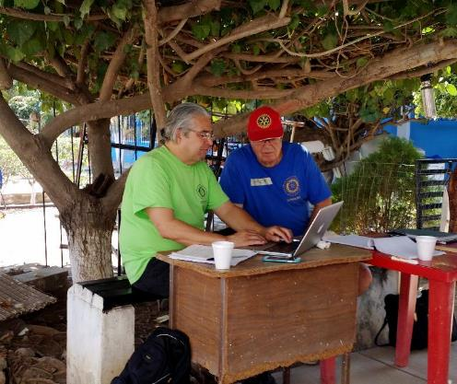
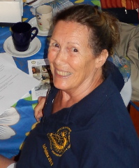
Humanitarian Projects:
2015 La Prepa
MA
N
A
G
EME
N
T

Slide 25
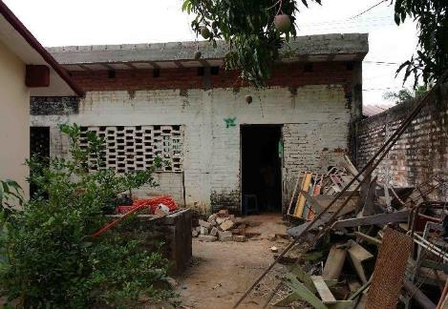
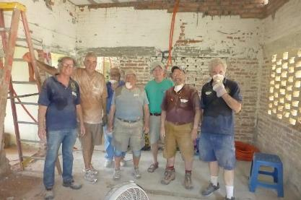
Humanitarian Projects:
2015 Las Palmas Primary
E
X
I
S
T
I
N
G
Teacher’s quarters
Computer lab
The dirty dozen
A new partner
BK’s Club from
Lake Norman, NC

Slide 26


2015 Las Palmas Primary
E
X
I
S
T
I
N
G
Teacher’s quarters
3 hour daily commute
(round trip)

Slide 27


2015 Las Palmas Computer lab
E
X
I
S
T
I
N
G
Teacher’s quarters
Computer Lab in use

Slide 28


Las Varas 2018
Felipe Angeles Primary
PAINTING
and
COMPUTER LAB

Slide 29



Las Varas 2018
Felipe Angeles Primary

Slide 30


During COVID & beyond
Food support La Penita & Chacala
Computers for La Prepa Teachers
Second computer lab Felipe Angeles
Solar for La Prepa
AND
LOS AYALA KINDERGARTEN

Slide 31



PLANNING
JOIN THE TEAM

Slide 32


La Penita & Berkeley Rotarians

Slide 33


Leadership
3 Global Grants
15 Projects

Slide 34



